Slide 1
Lazzaro_art doesn’t sleep
Claudia Pecoraro
museologa, curatrice

Slide 2
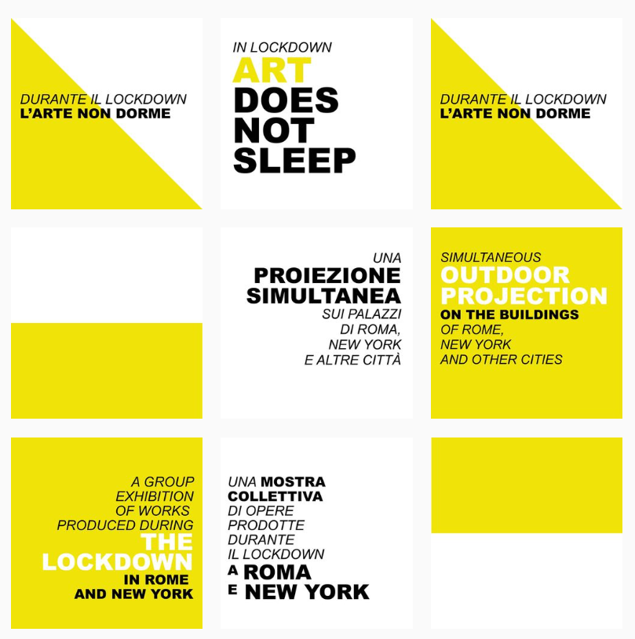
a project by
Laura Mega & Claudia Pecoraro
Lazzaro_art doesn’t sleep Claudia Pecoraro

Slide 3
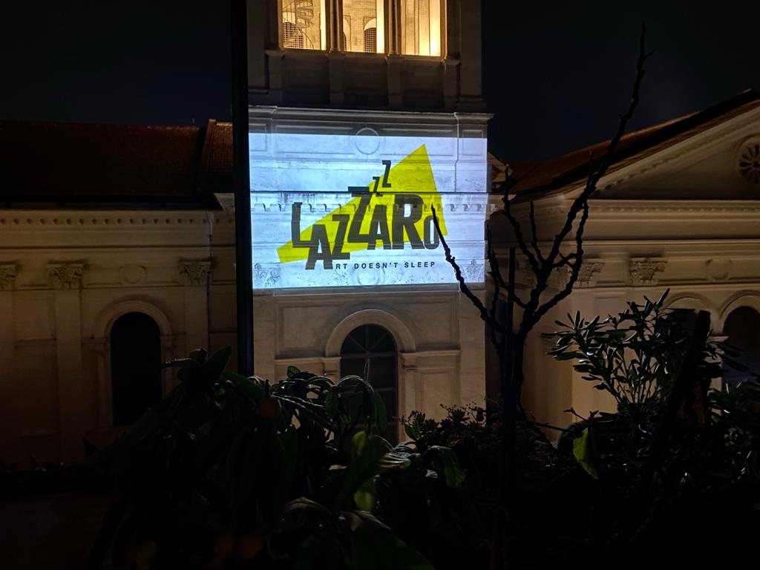
Prima edizione | 17 maggio 2020 | h 22.30 | Roma e New York
Lazzaro_art doesn’t sleep Claudia Pecoraro

Slide 4
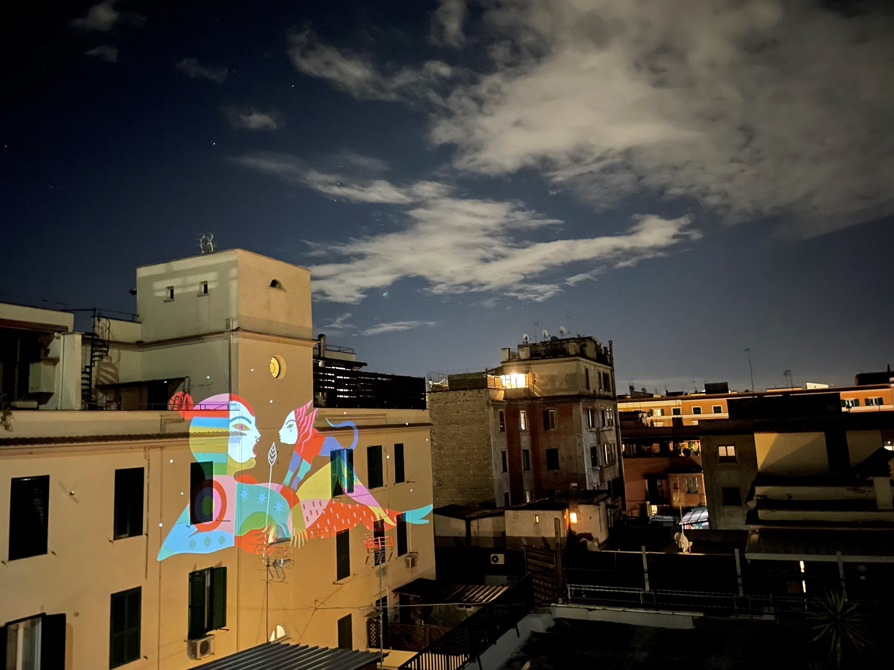
Roma
Lazzaro_art doesn’t sleep Claudia Pecoraro

Slide 5
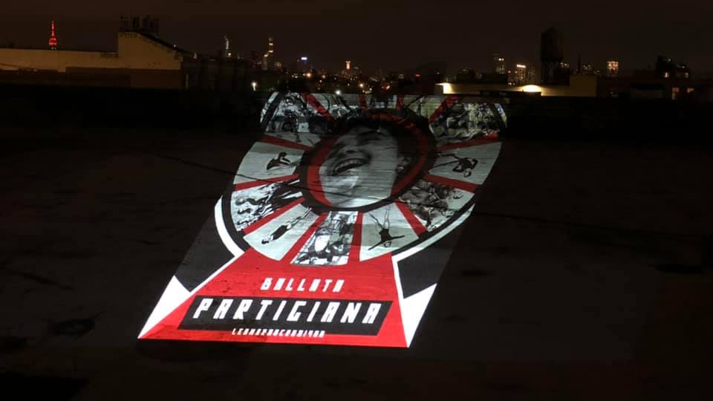
New York
Lazzaro_art doesn’t sleep Claudia Pecoraro

Slide 6
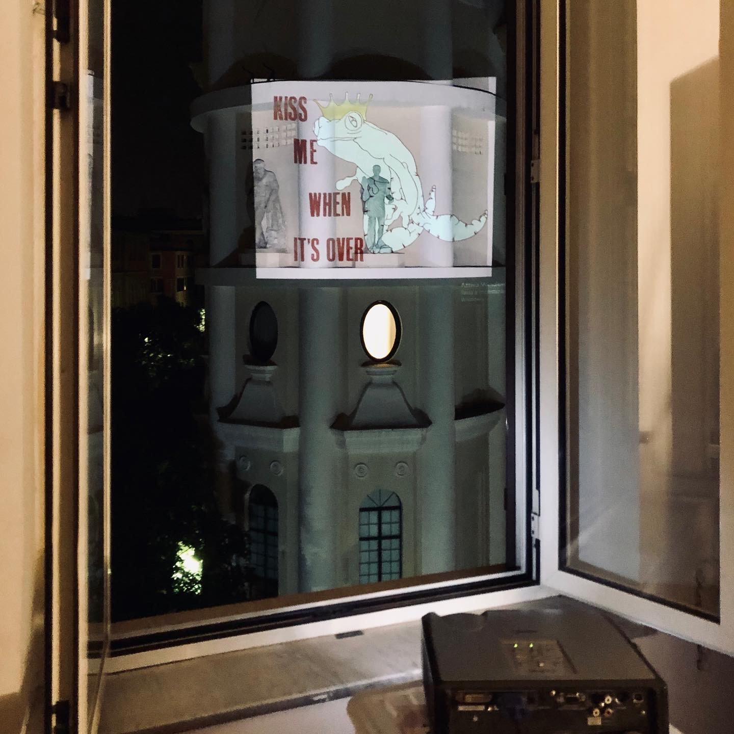
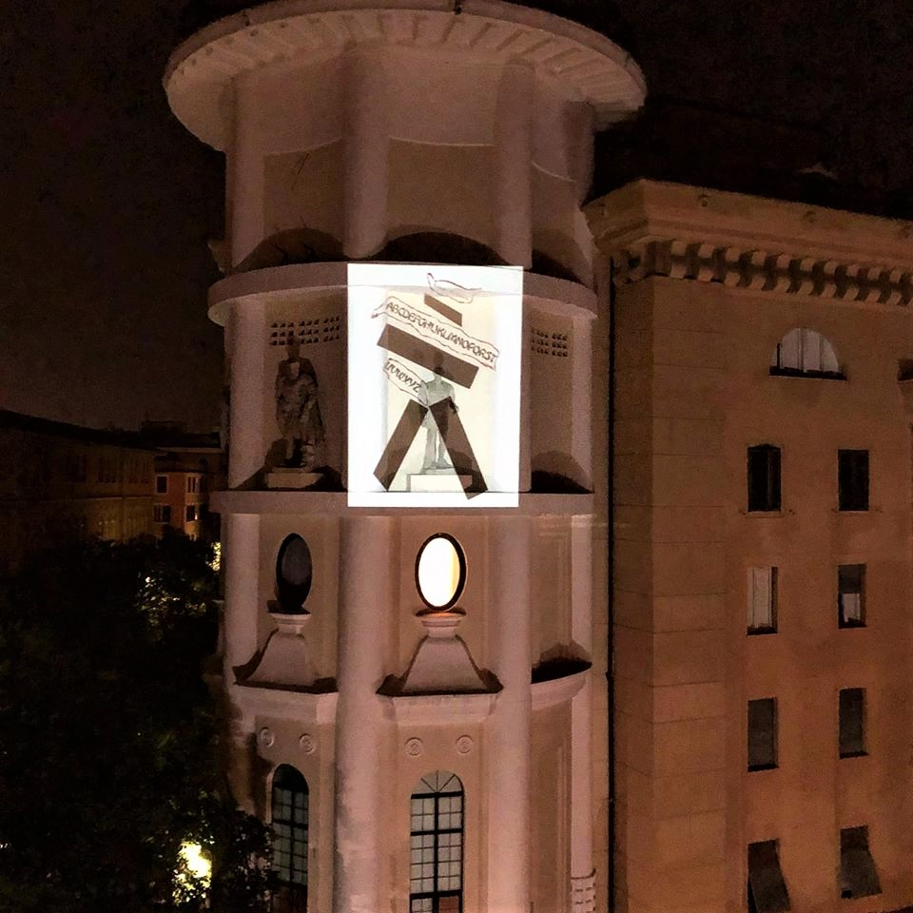
Roma
Lazzaro_art doesn’t sleep Claudia Pecoraro

Slide 7
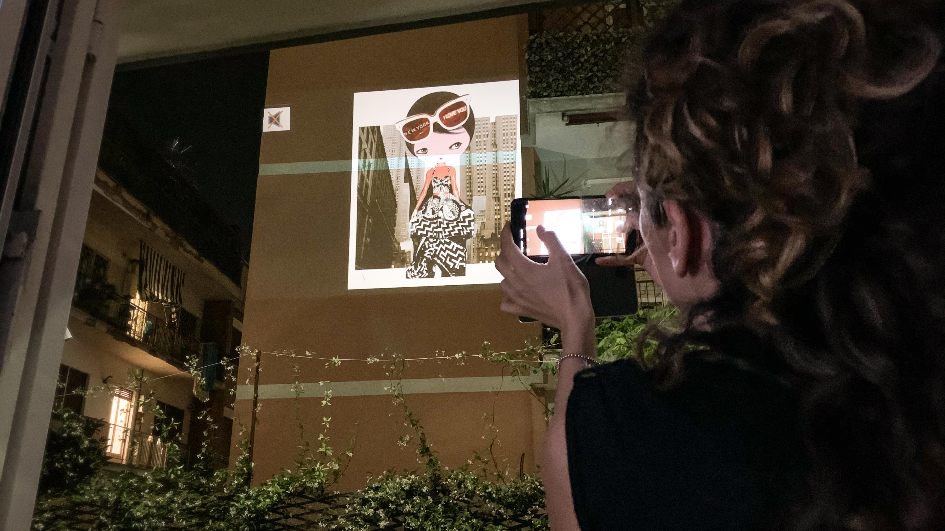
Roma
Lazzaro_art doesn’t sleep Claudia Pecoraro

Slide 8
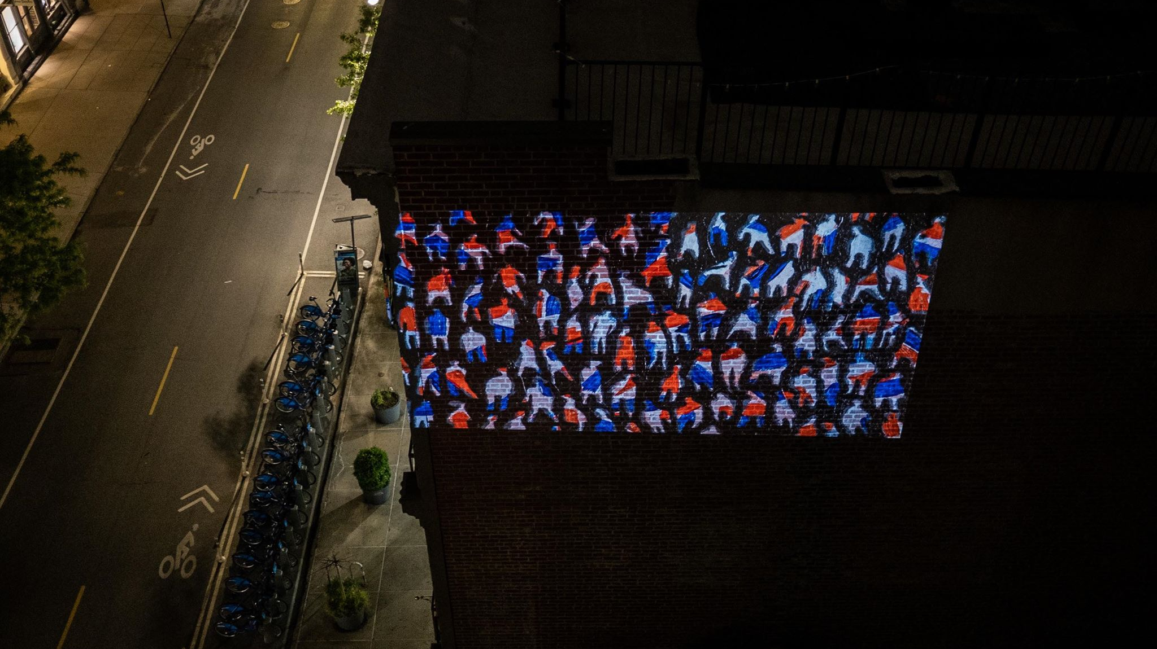
New York
Lazzaro_art doesn’t sleep Claudia Pecoraro

Slide 9
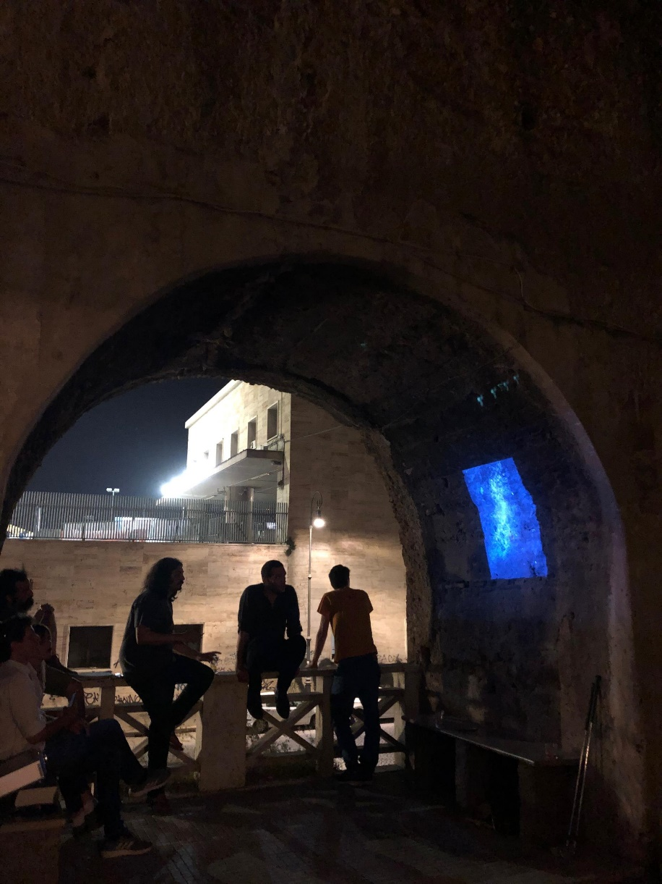
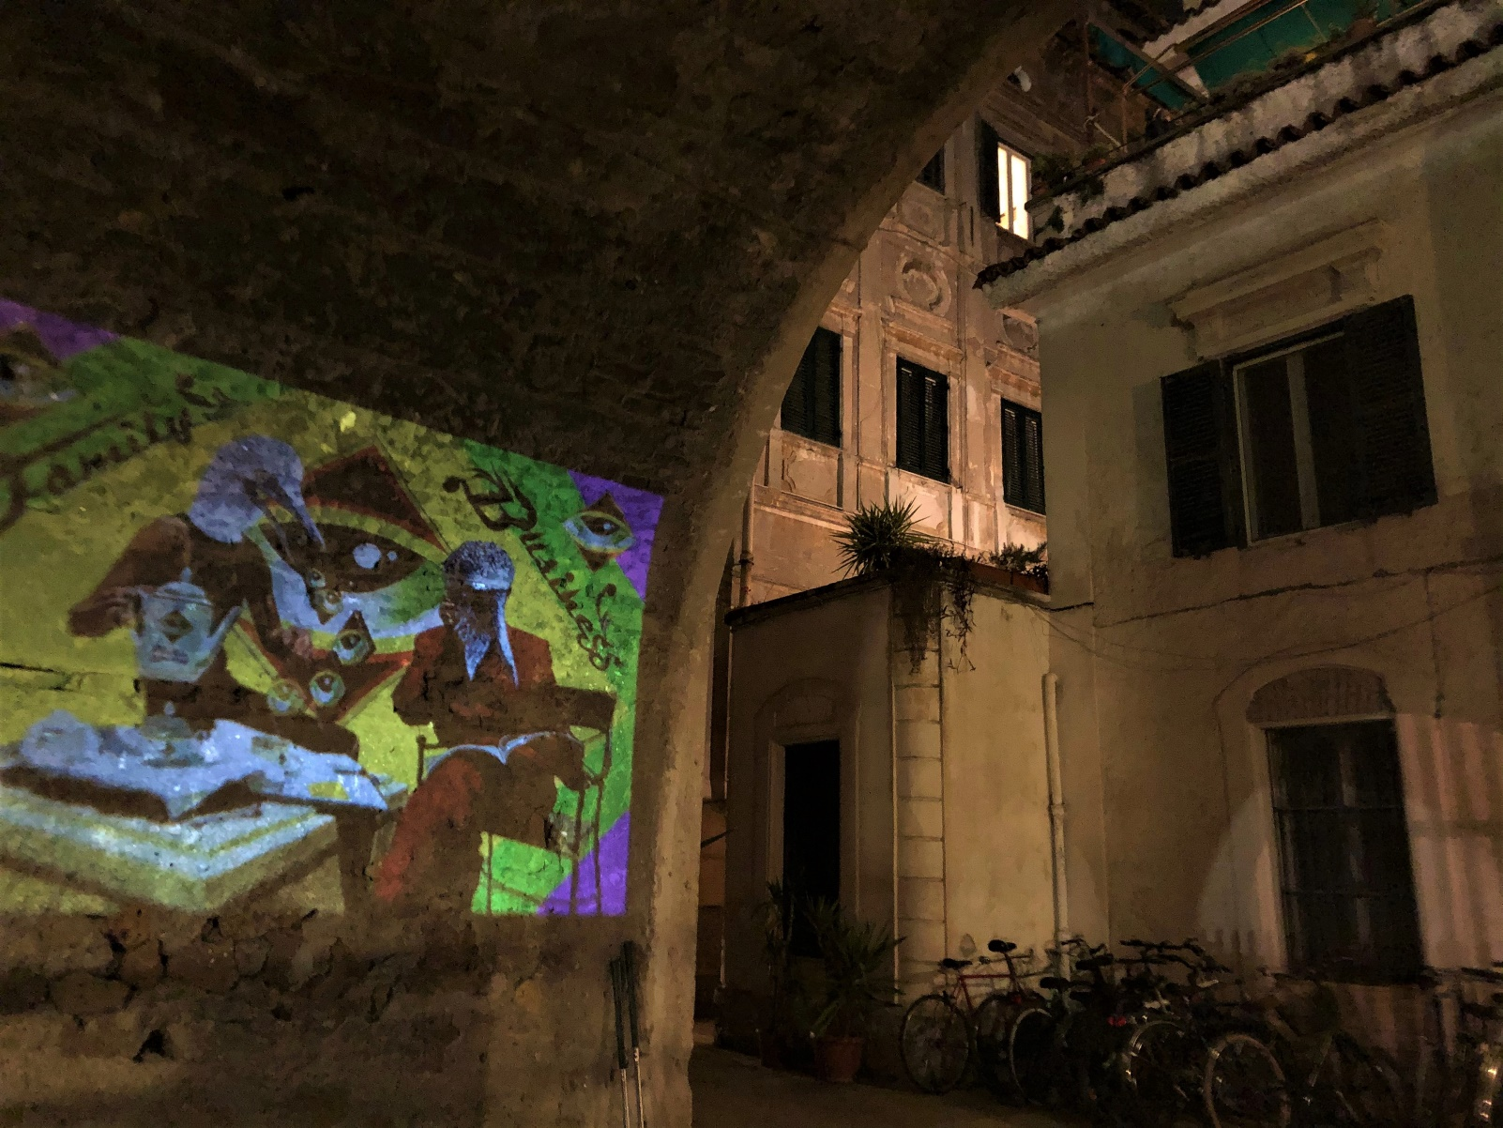
Roma
Lazzaro_art doesn’t sleep Claudia Pecoraro

Slide 10
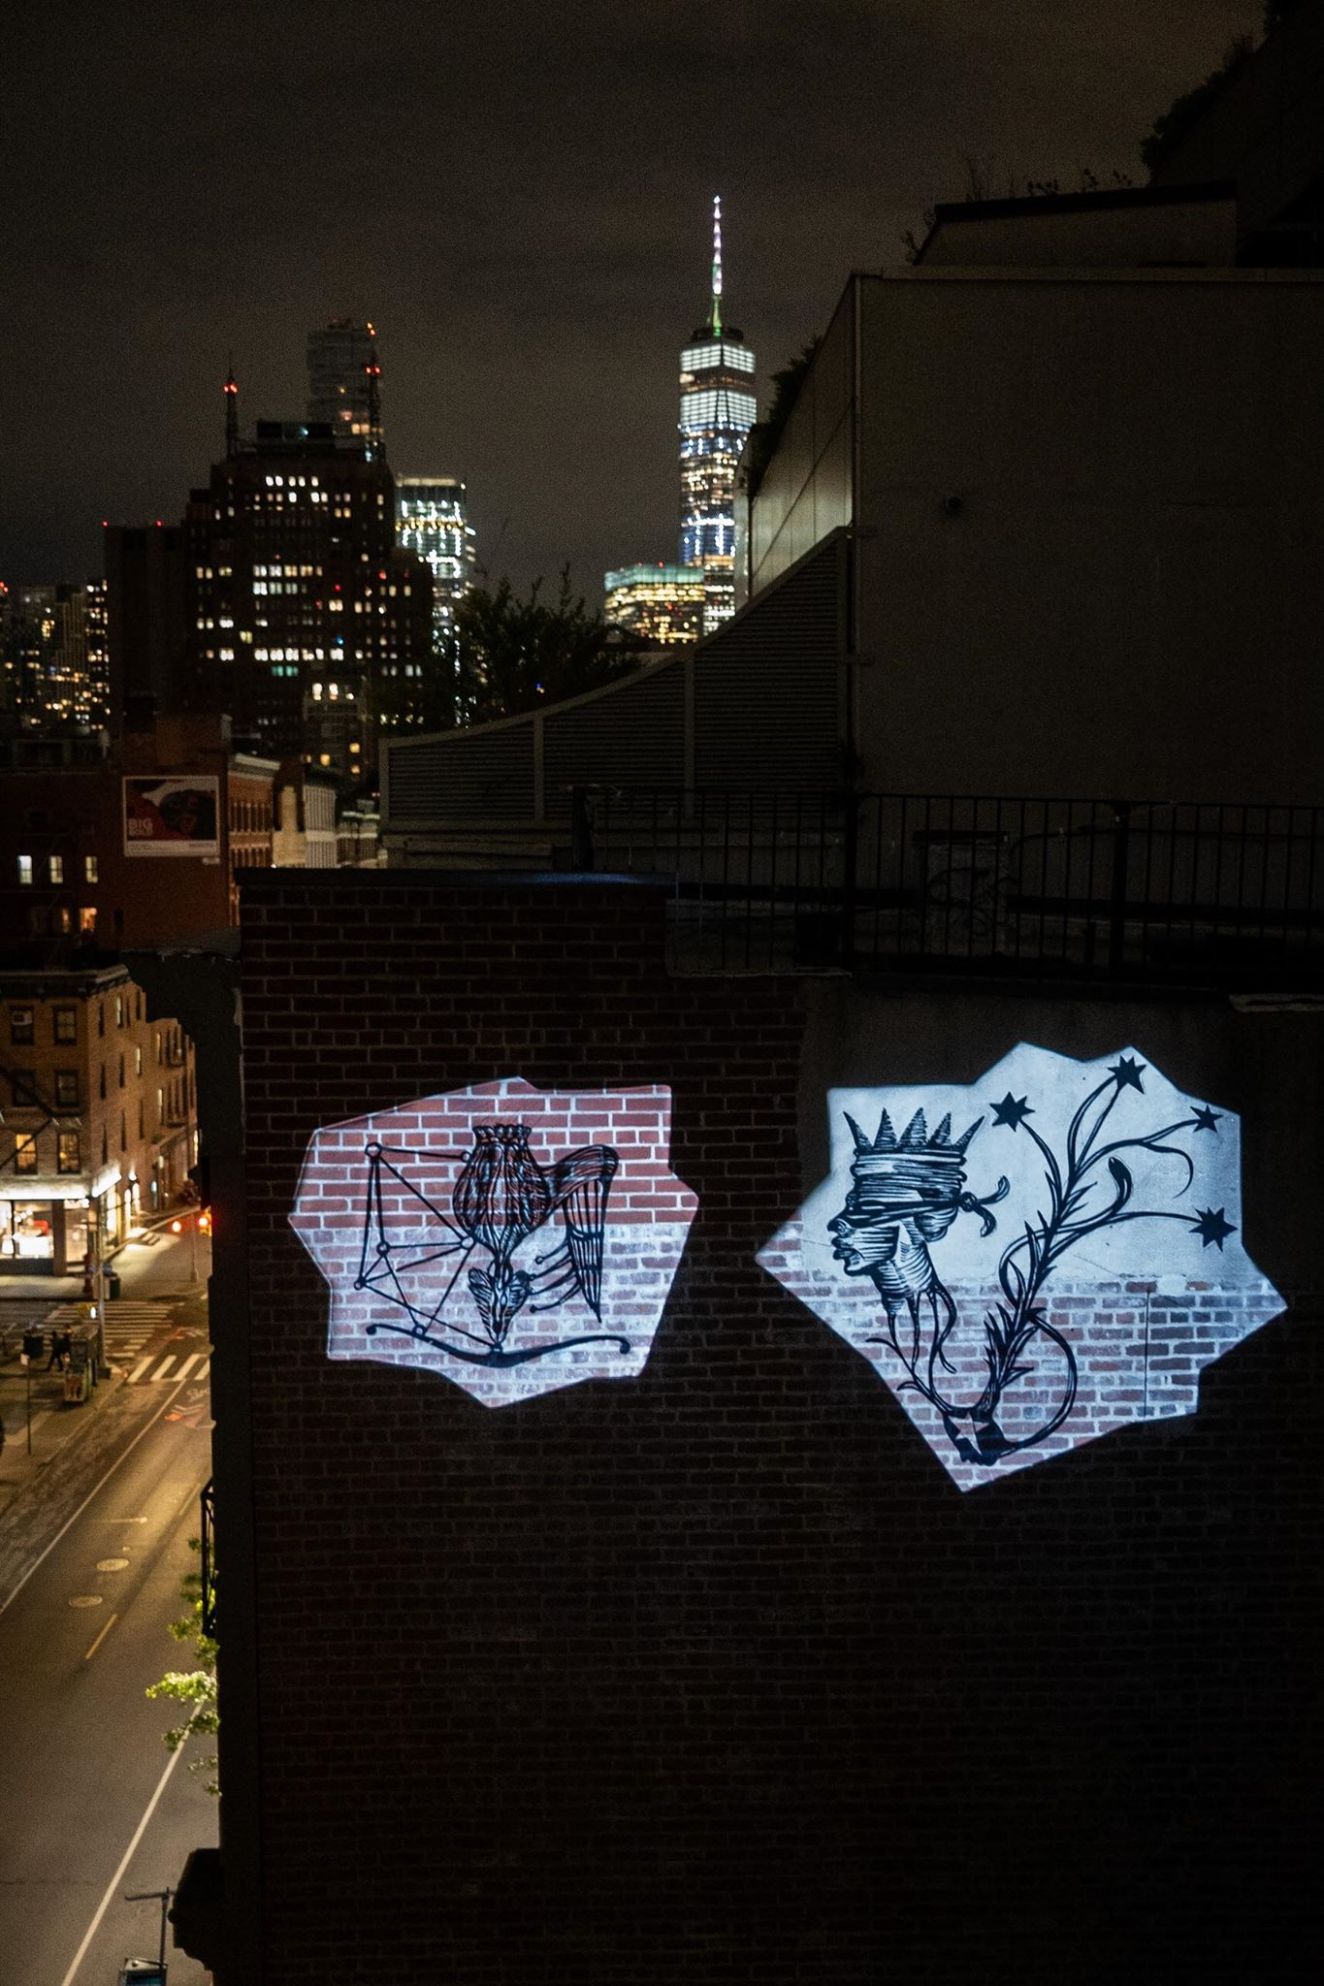
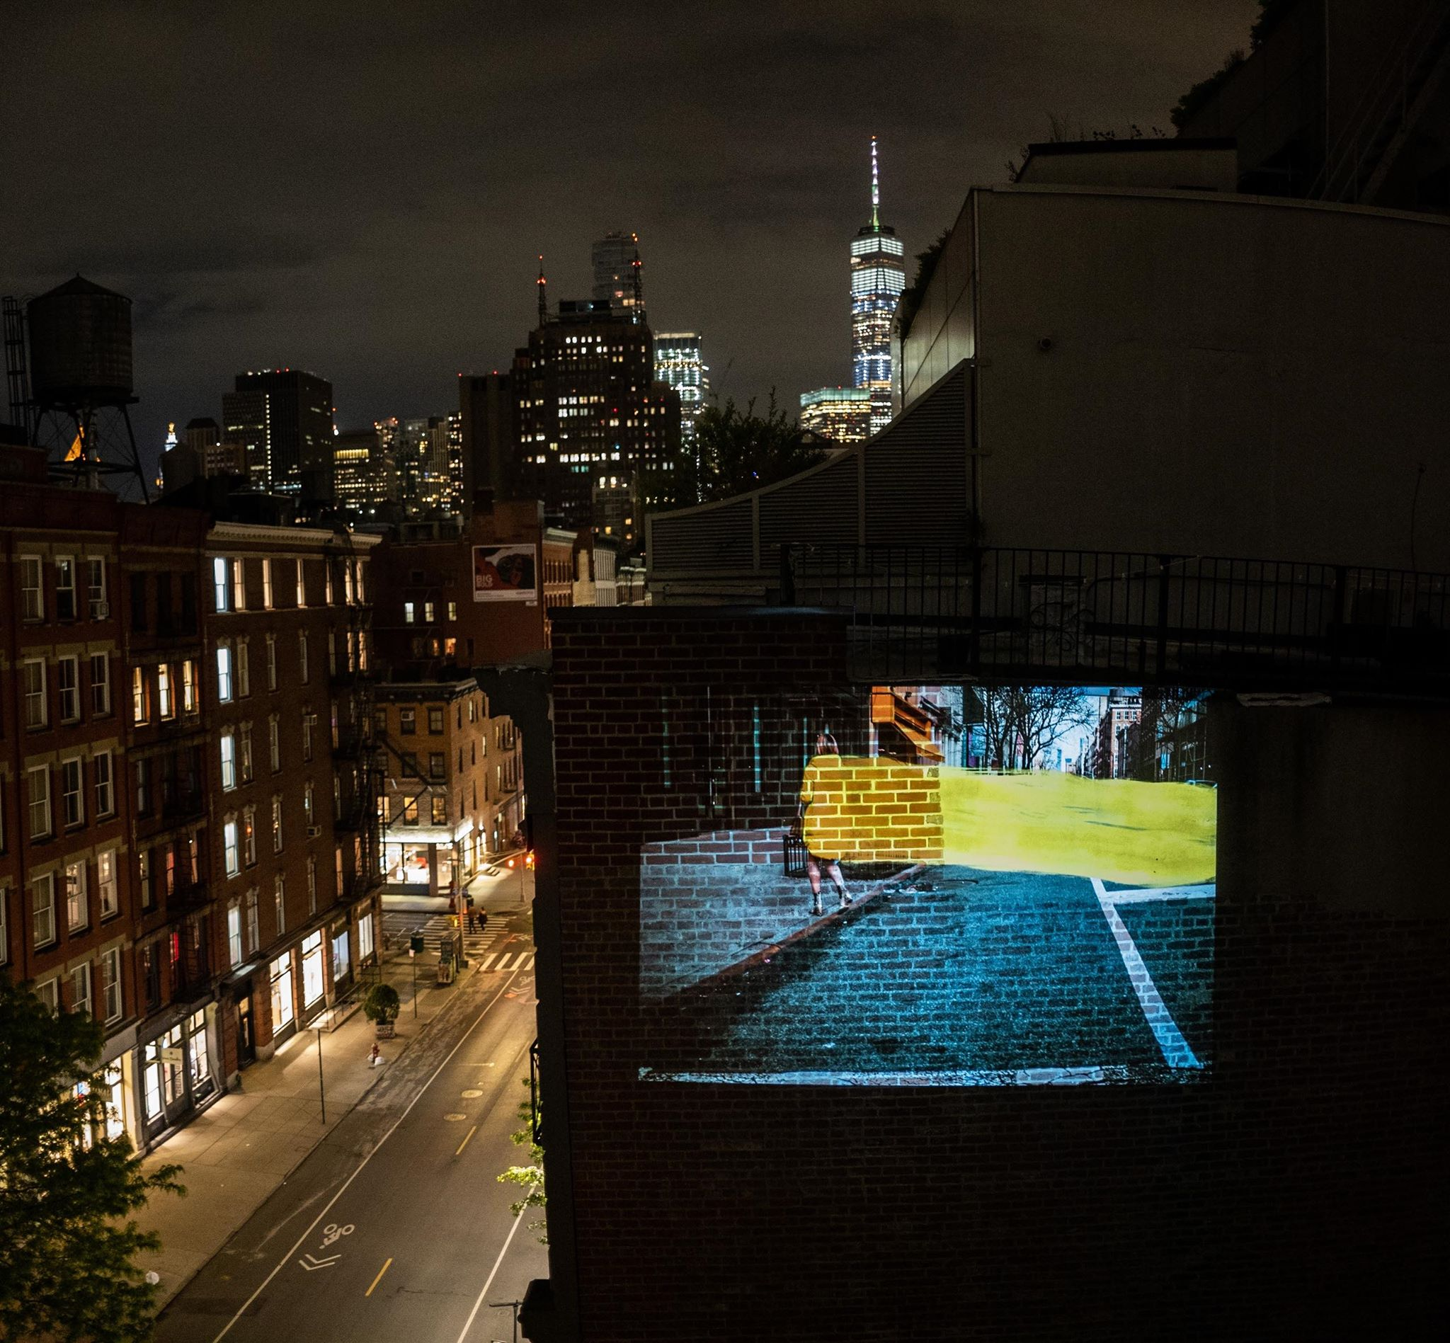
New York
Lazzaro_art doesn’t sleep Claudia Pecoraro

Slide 11
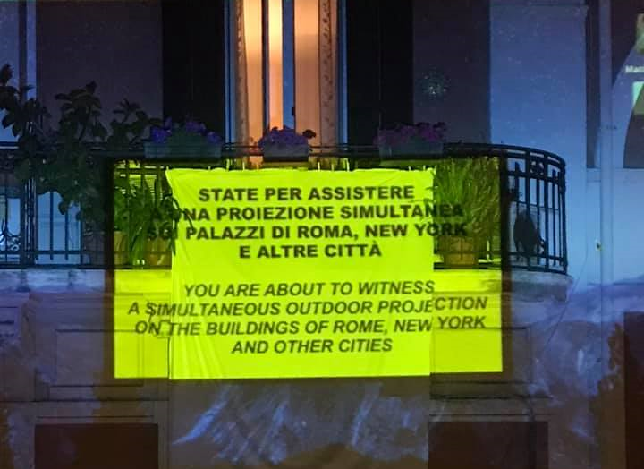
Diretta da Bari con djset techno
https://www.facebook.com/551799255/videos/10159626216524256 (1’49 - 3’30)/
Lazzaro_art doesn’t sleep Claudia Pecoraro

Slide 12
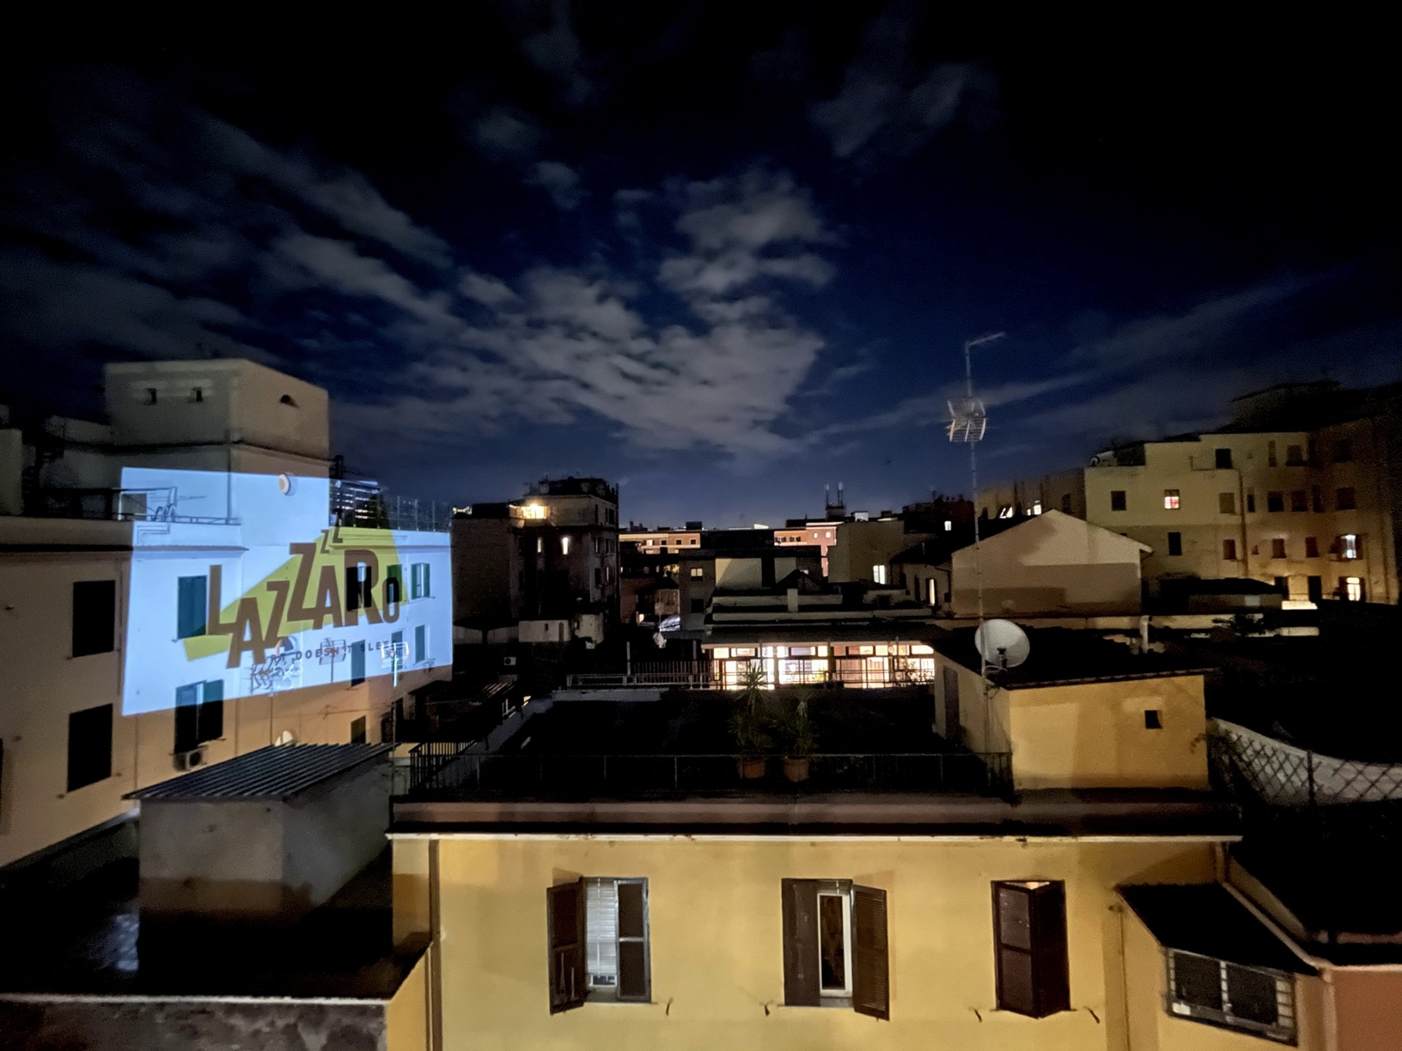
Roma
Lazzaro_art doesn’t sleep Claudia Pecoraro

Slide 13
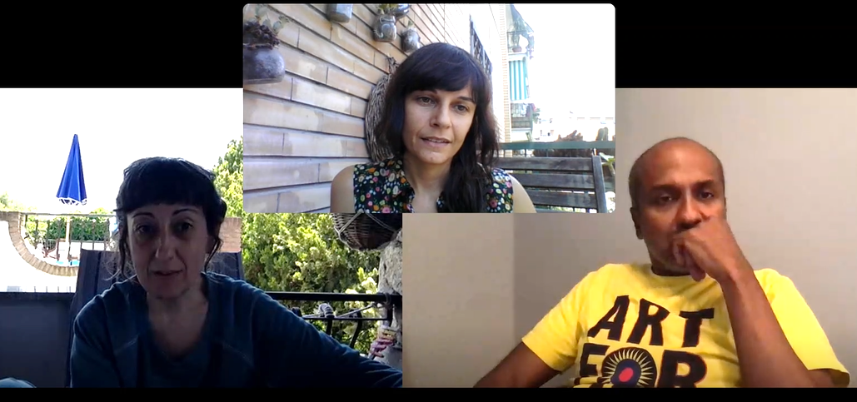
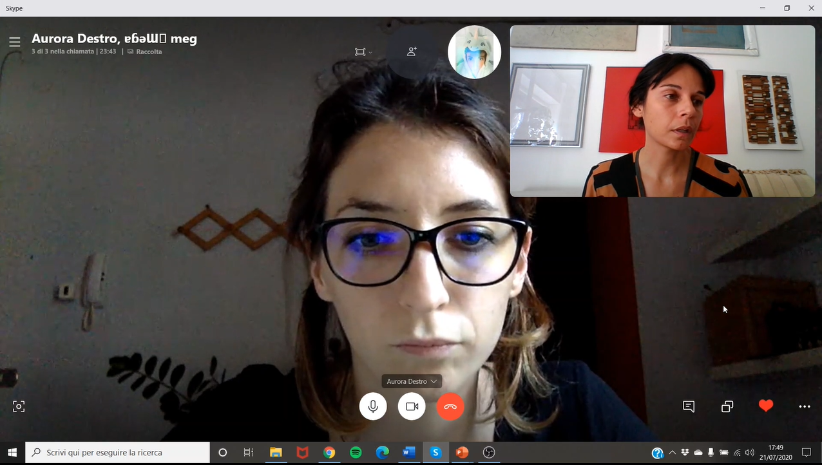
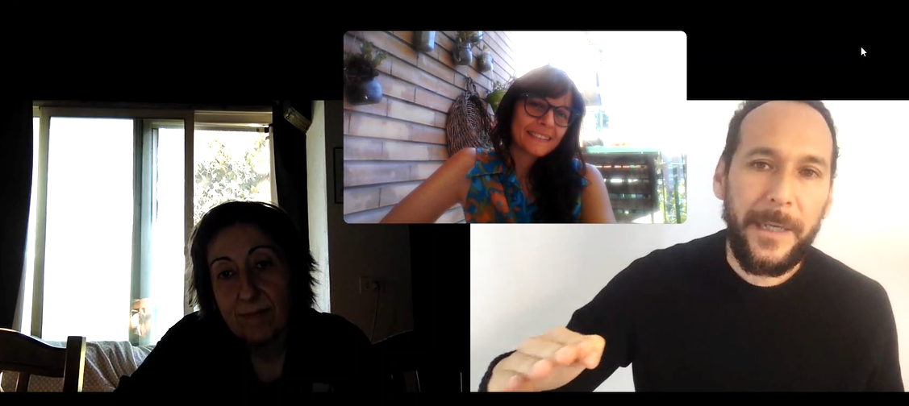
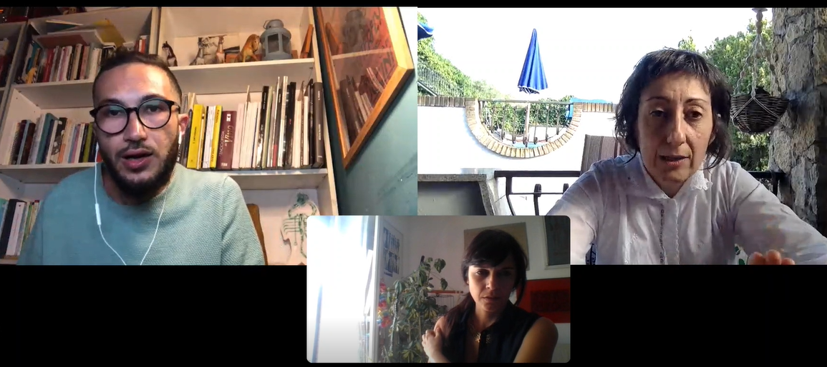
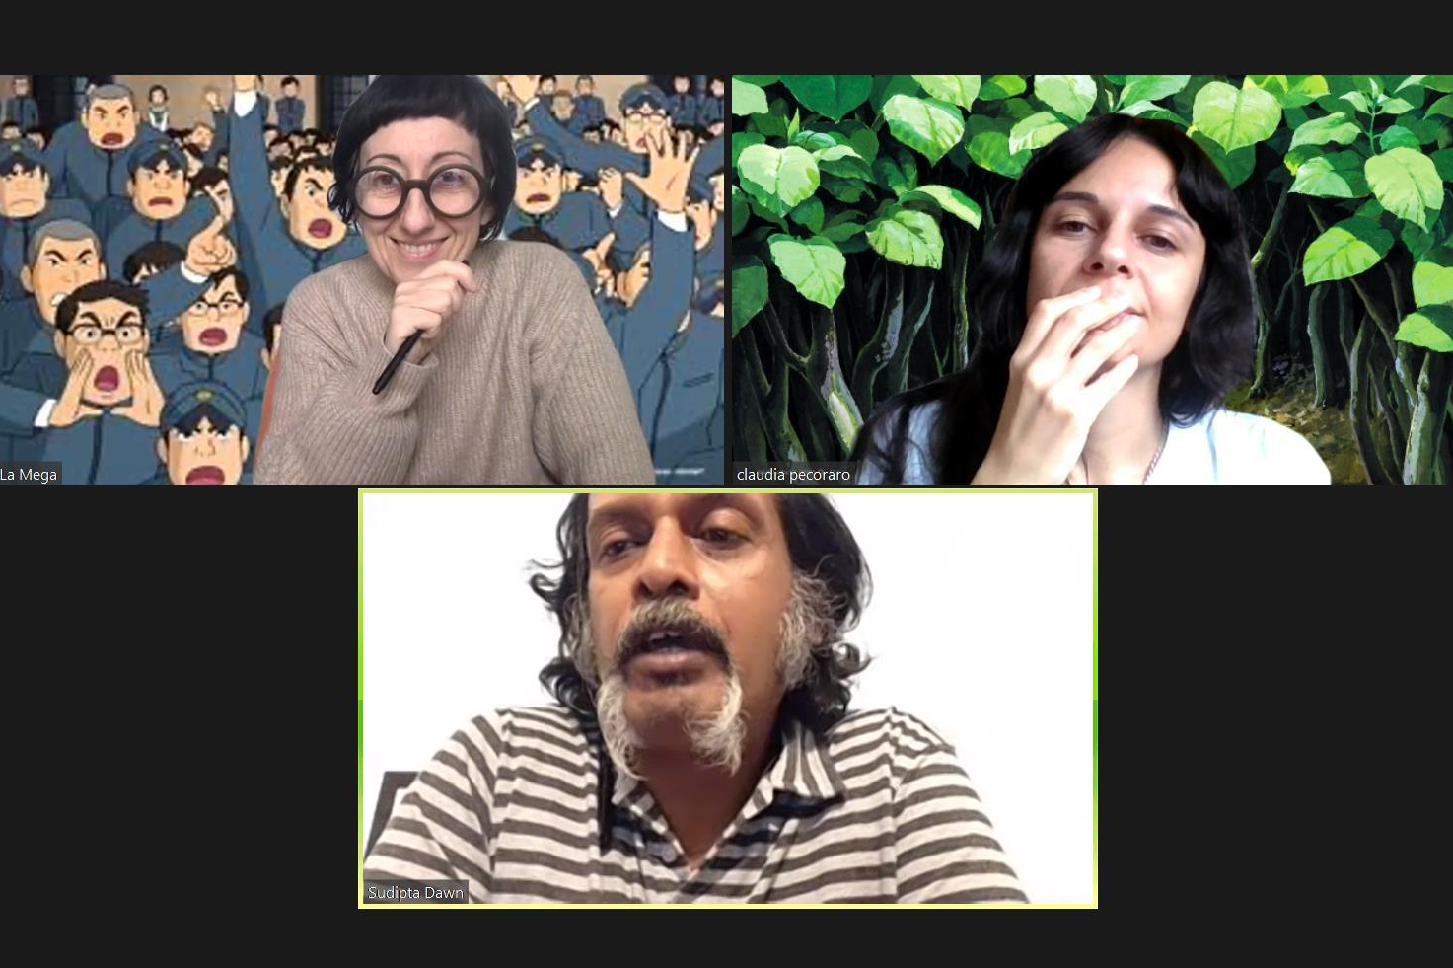
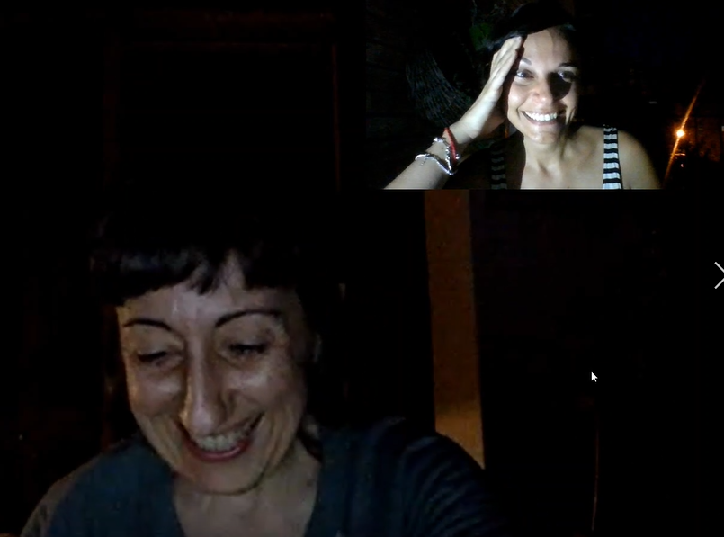
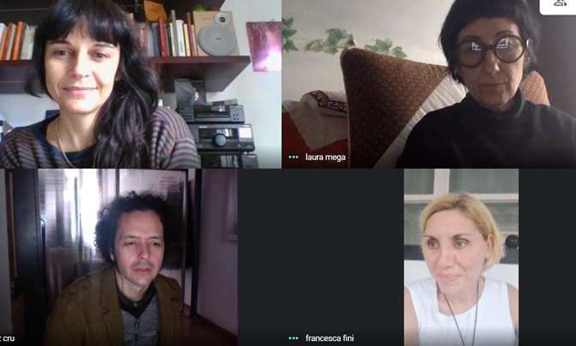
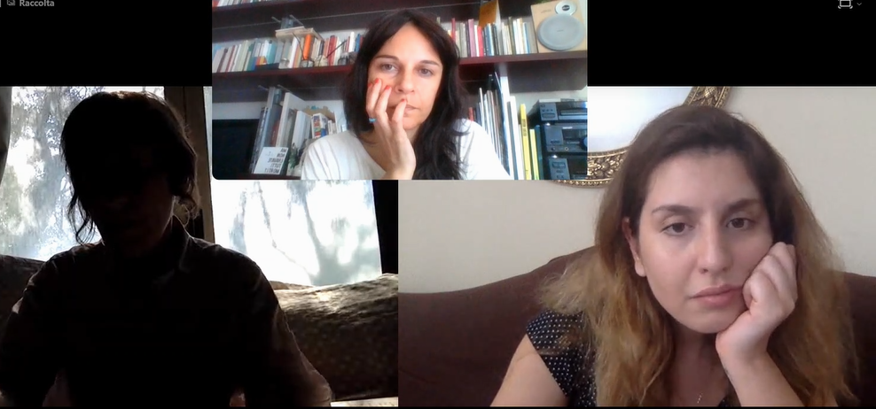
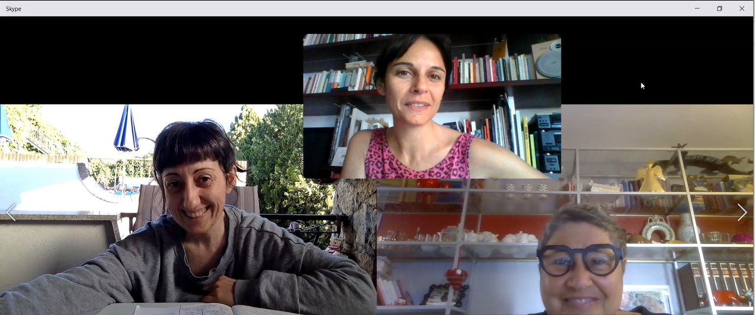
Lazzaro_art doesn’t sleep Claudia Pecoraro

Slide 14
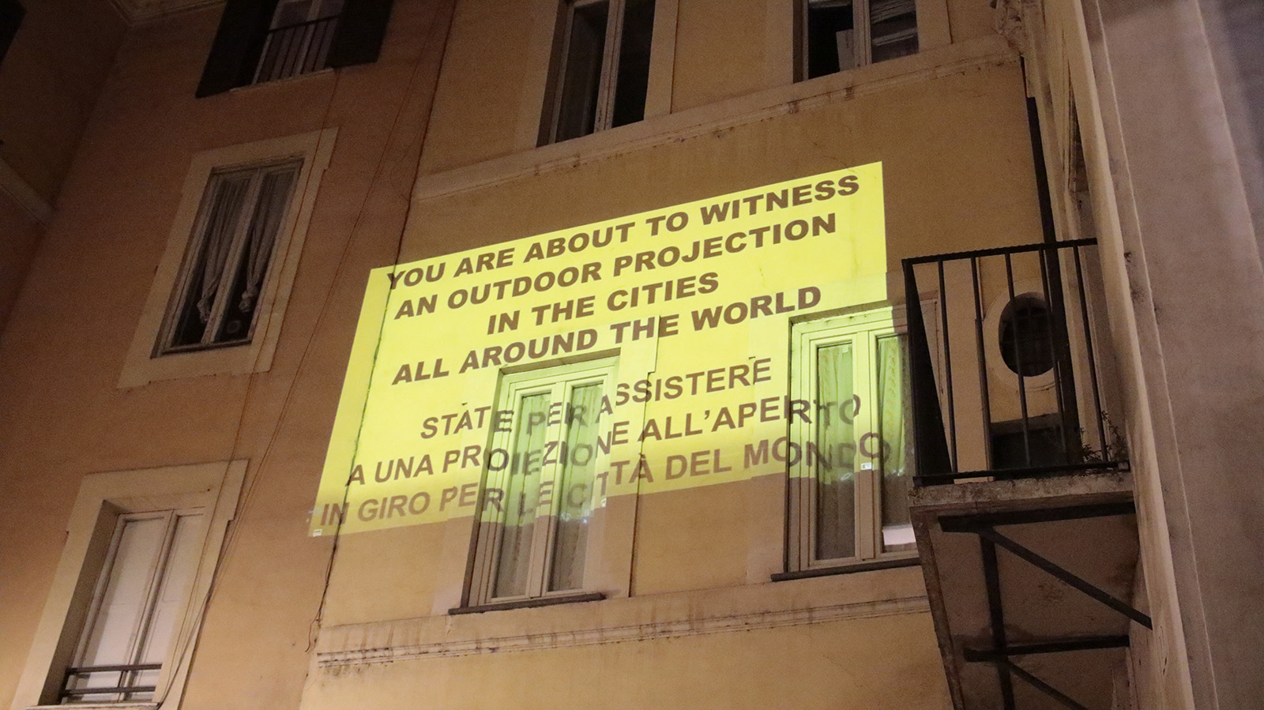
Roma
Lazzaro_art doesn’t sleep Claudia Pecoraro

Slide 15
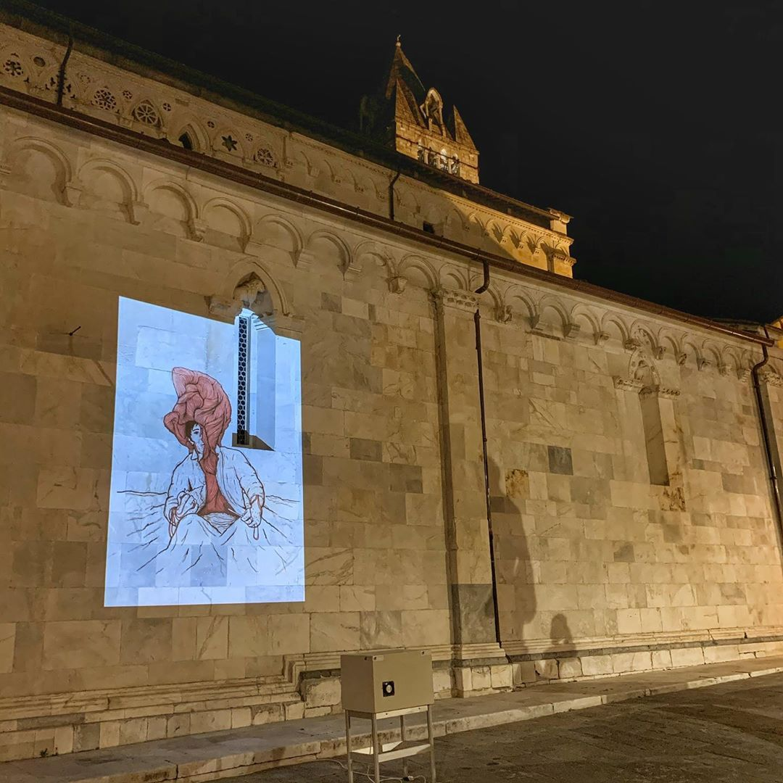
Carrara
Lazzaro_art doesn’t sleep Claudia Pecoraro

Slide 16
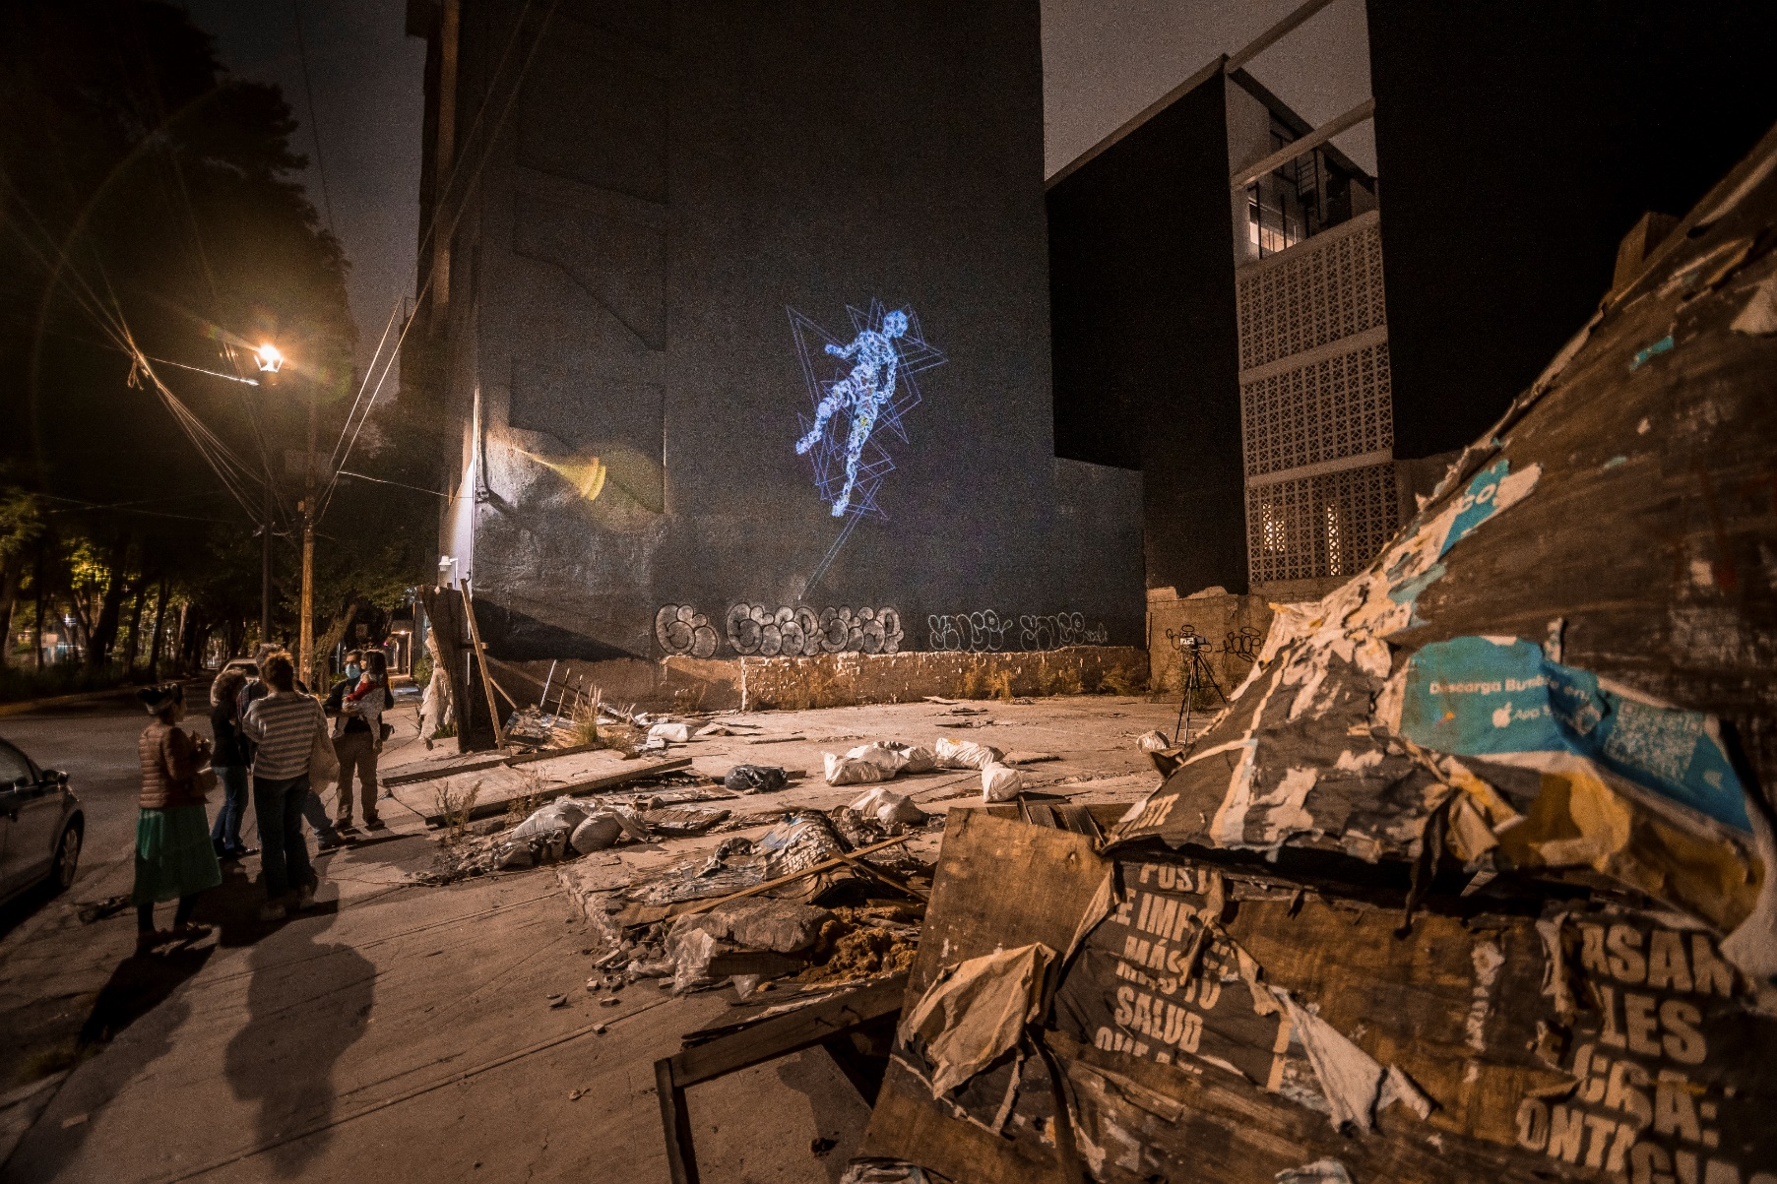
Città del Messico
Lazzaro_art doesn’t sleep Claudia Pecoraro

Slide 17
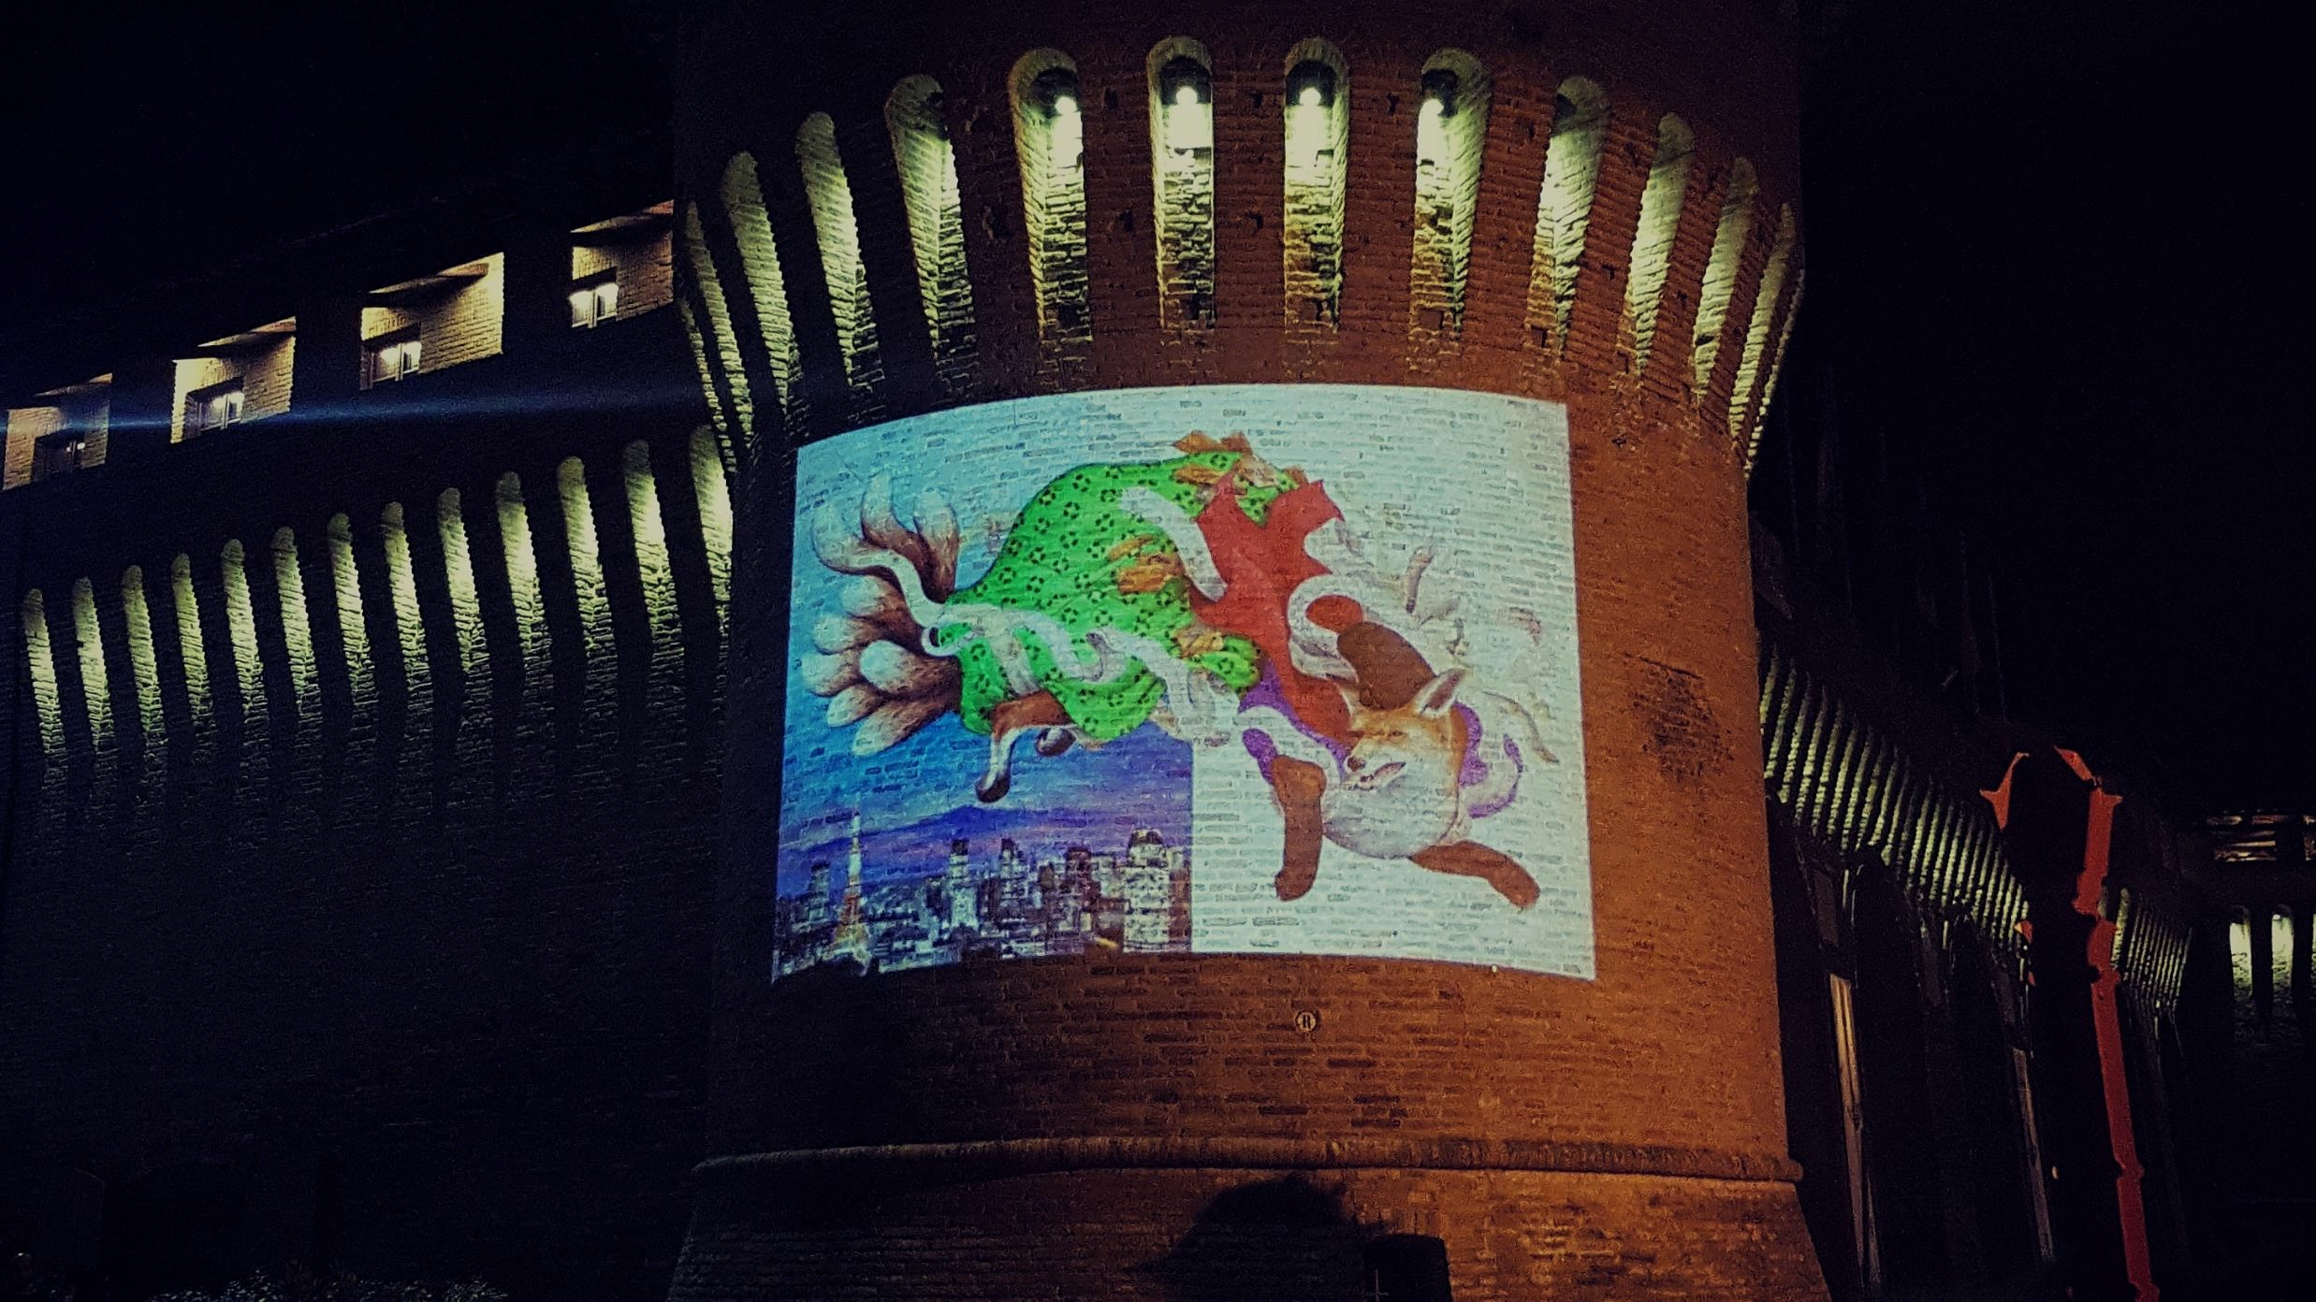
Forlimpopoli (Forlì-Cesena)
Lazzaro_art doesn’t sleep Claudia Pecoraro

Slide 18
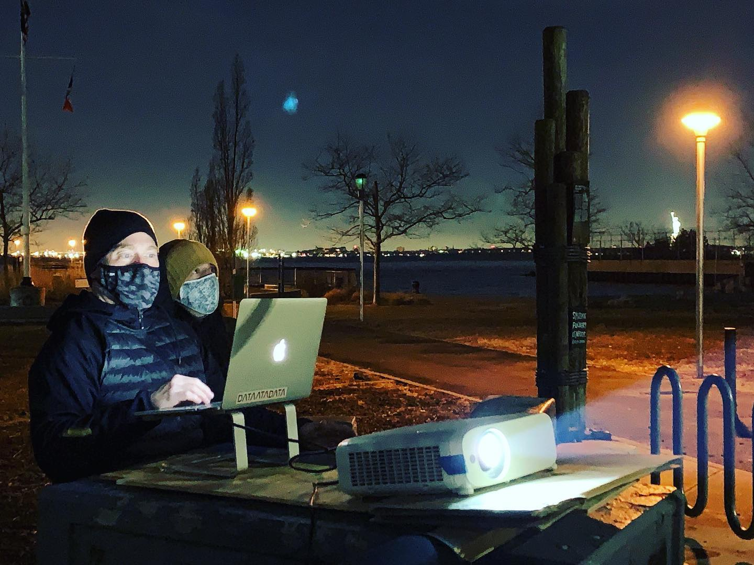
New York
Lazzaro_art doesn’t sleep Claudia Pecoraro

Slide 19
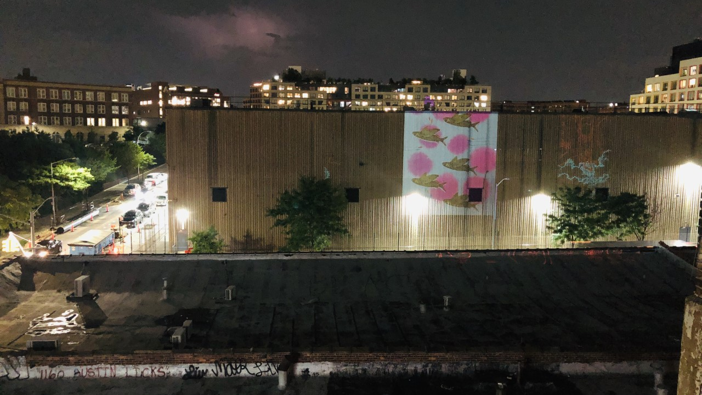
New York
Lazzaro_art doesn’t sleep Claudia Pecoraro

Slide 20
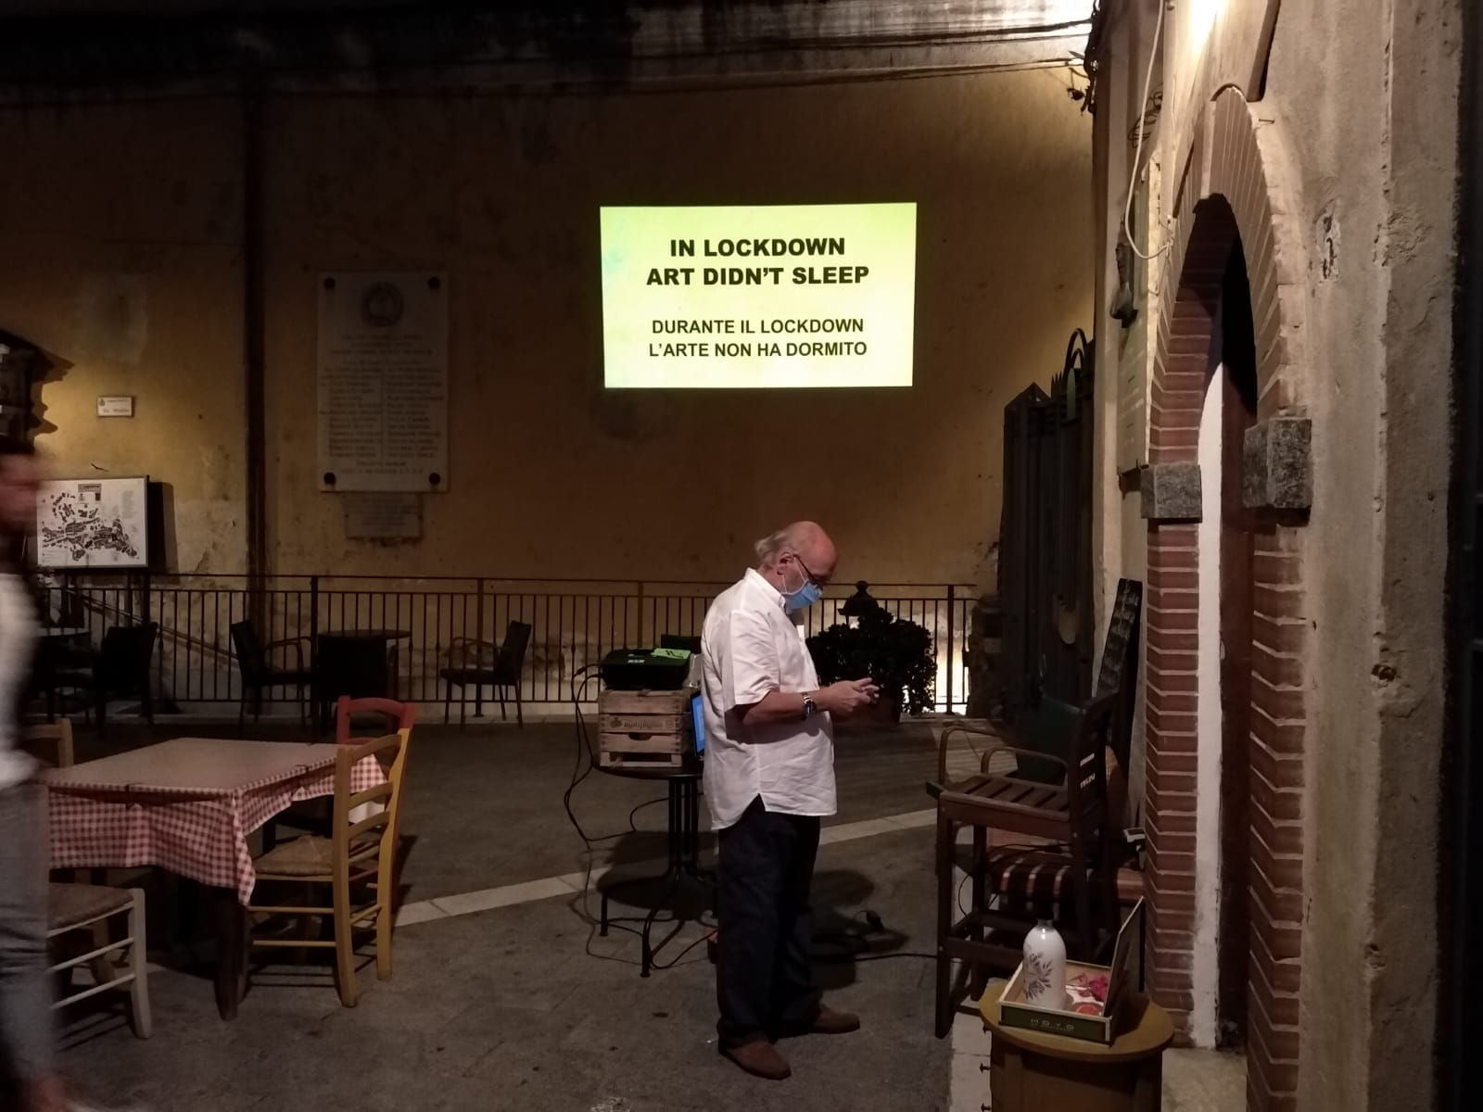
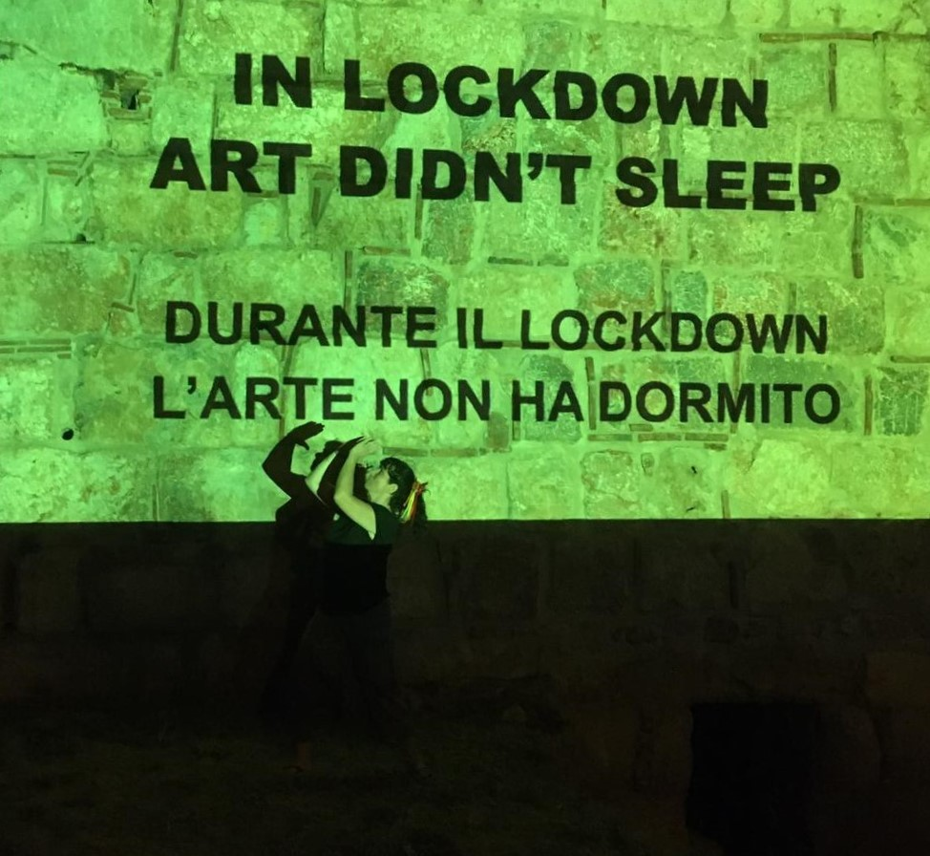
Pisciotta Cilento (Salerno) Izmir (Turchia)
Lazzaro_art doesn’t sleep Claudia Pecoraro

Slide 21
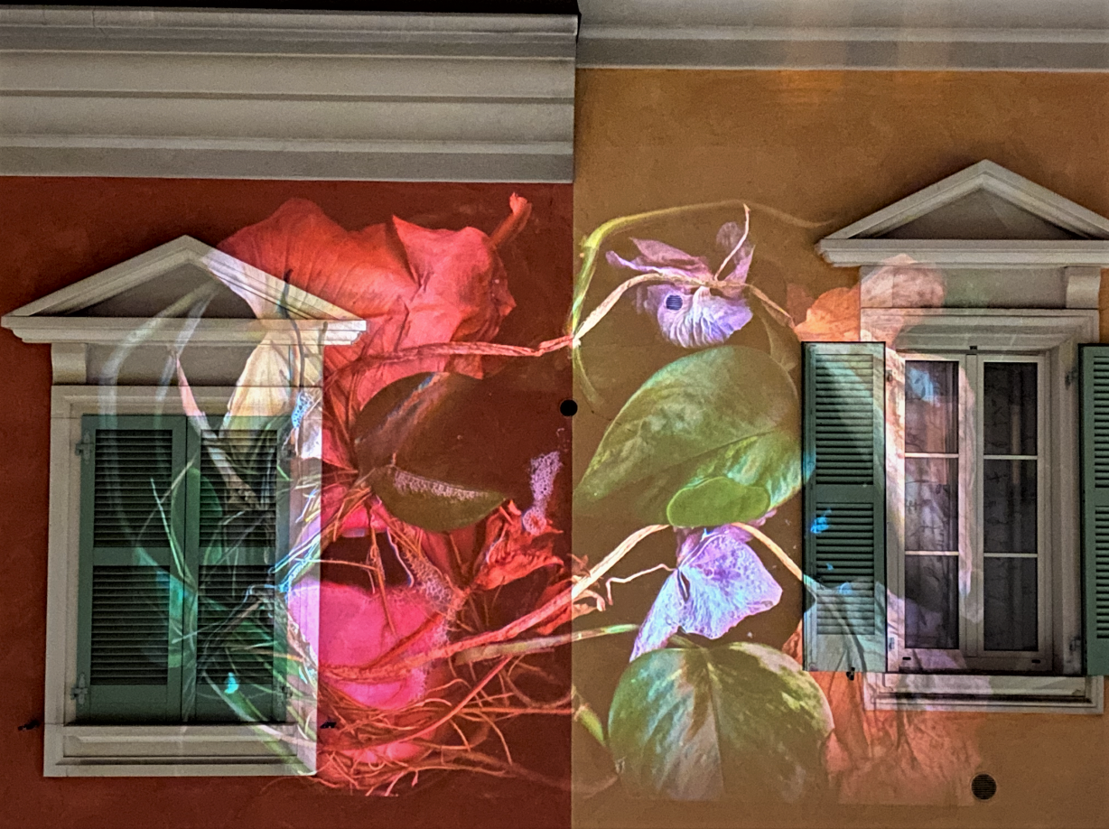
Milano
Lazzaro_art doesn’t sleep Claudia Pecoraro

Slide 22
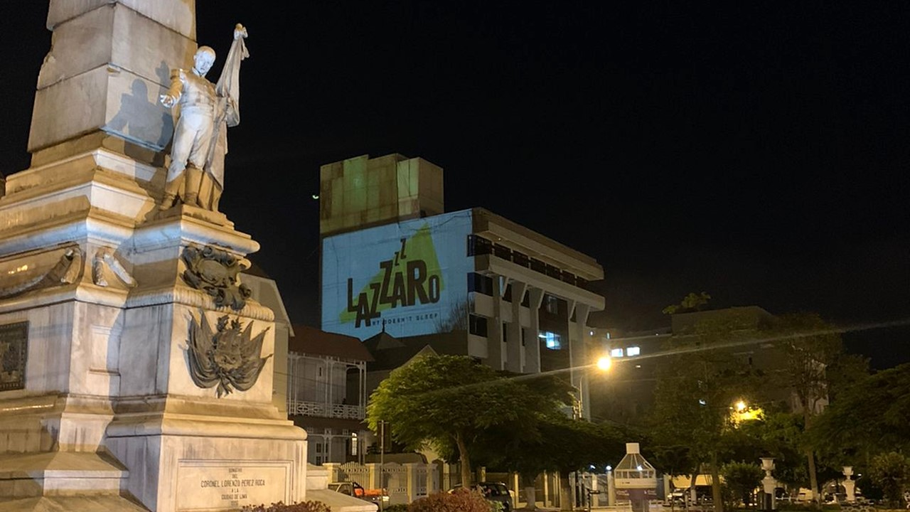
Lima
Lazzaro_art doesn’t sleep Claudia Pecoraro

Slide 23
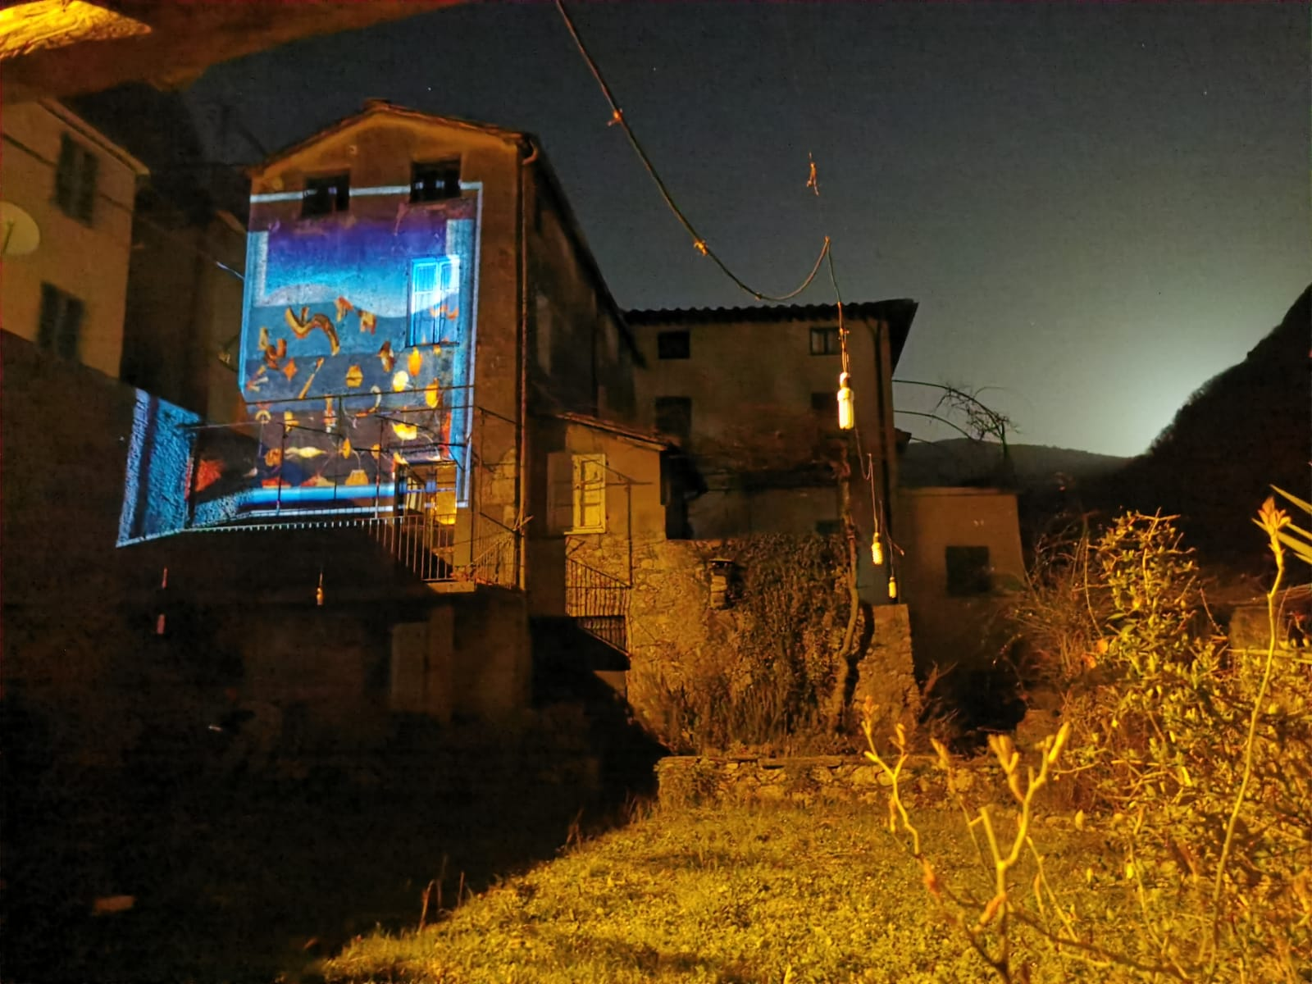
Casoli (Lucca)
Lazzaro_art doesn’t sleep Claudia Pecoraro

Slide 24
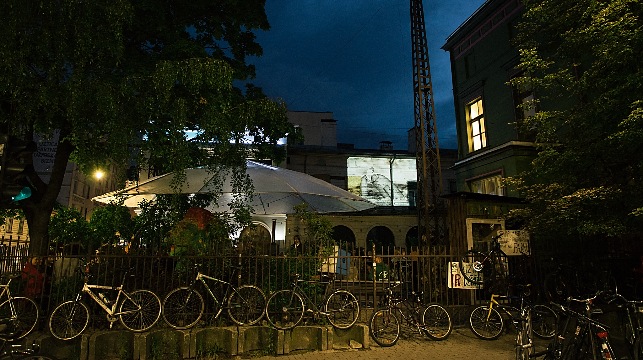
Riga
Lazzaro_art doesn’t sleep Claudia Pecoraro

Slide 25
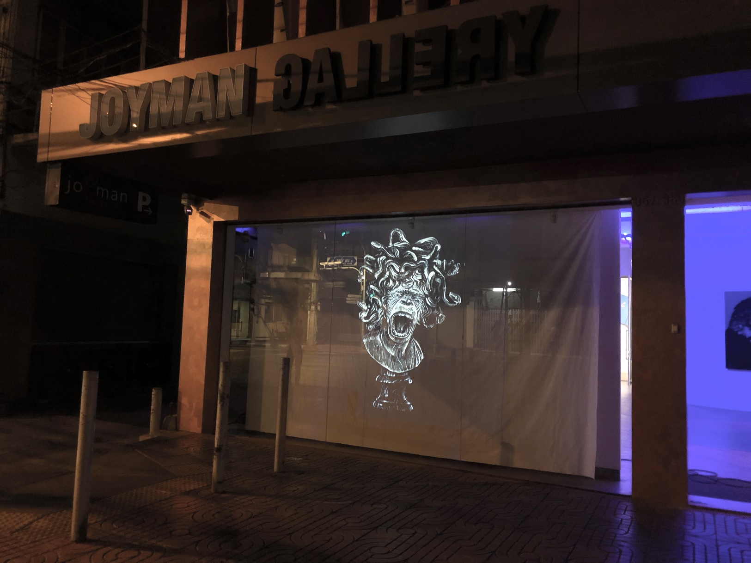
Bangkok
Lazzaro_art doesn’t sleep Claudia Pecoraro

Slide 26
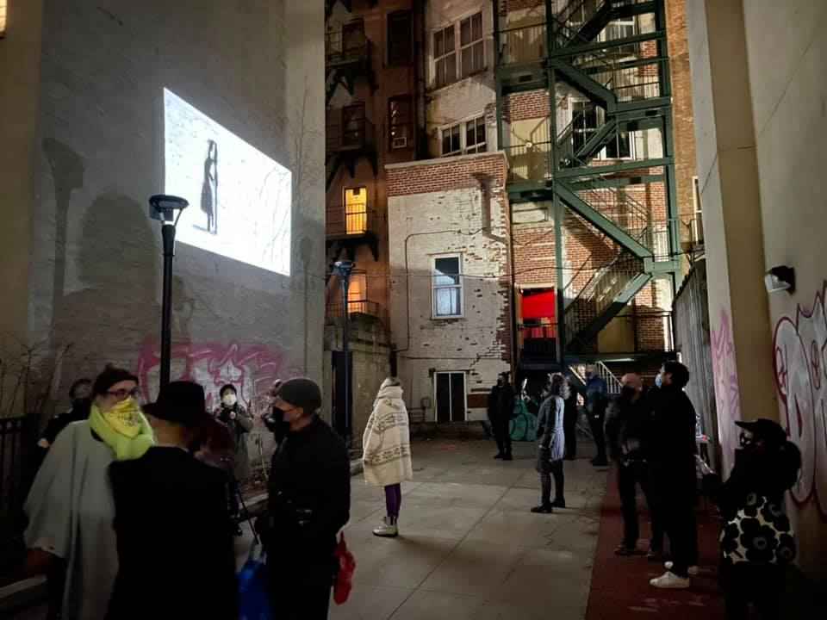
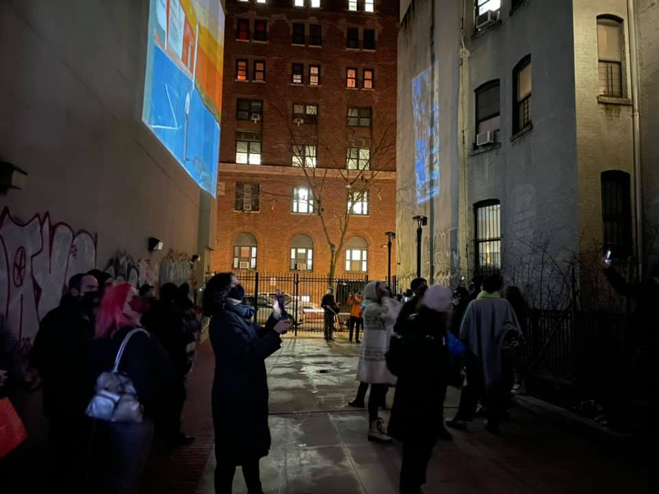
New York
Lazzaro_art doesn’t sleep Claudia Pecoraro

Slide 27
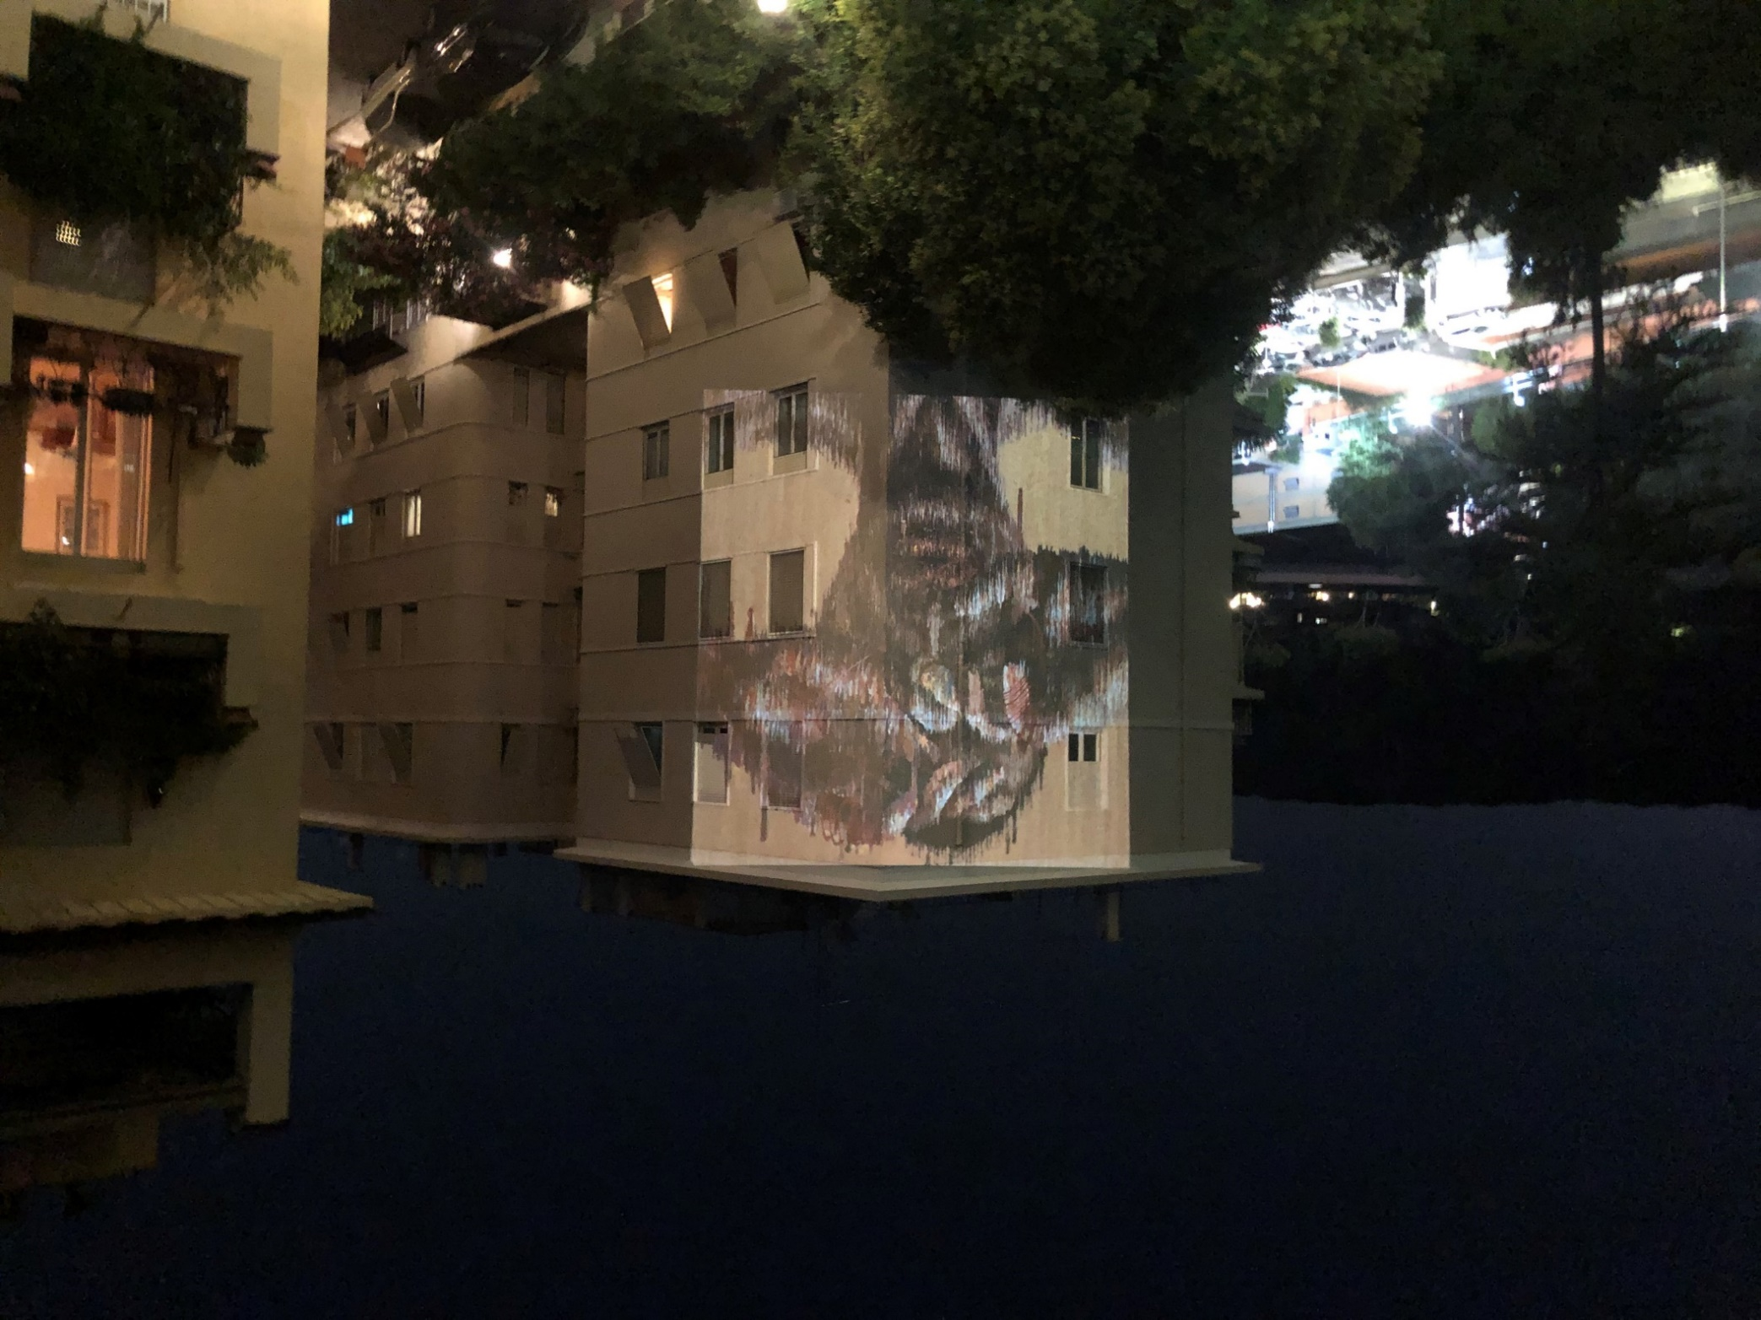
Roma
Lazzaro_art doesn’t sleep Claudia Pecoraro

Slide 28
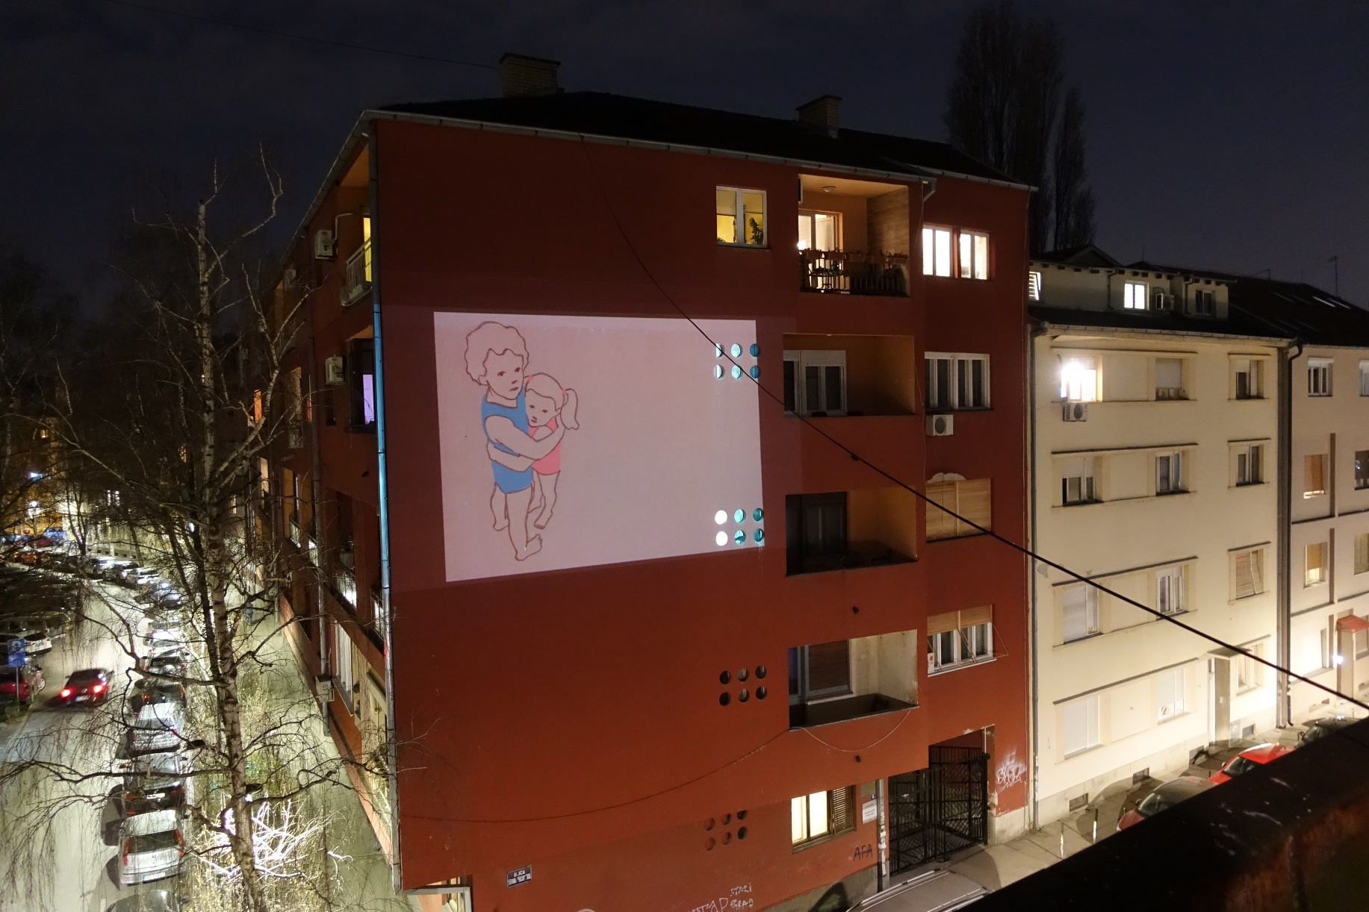
Novi Sad
Lazzaro_art doesn’t sleep Claudia Pecoraro

Slide 29
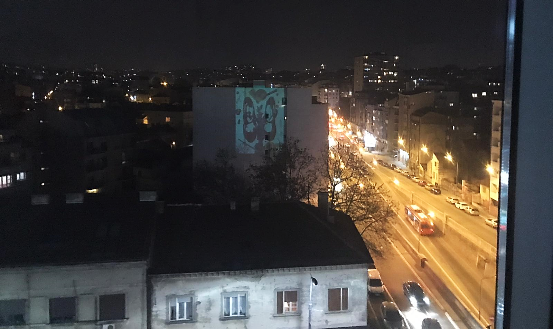
Belgrado
Lazzaro_art doesn’t sleep Claudia Pecoraro

Slide 30
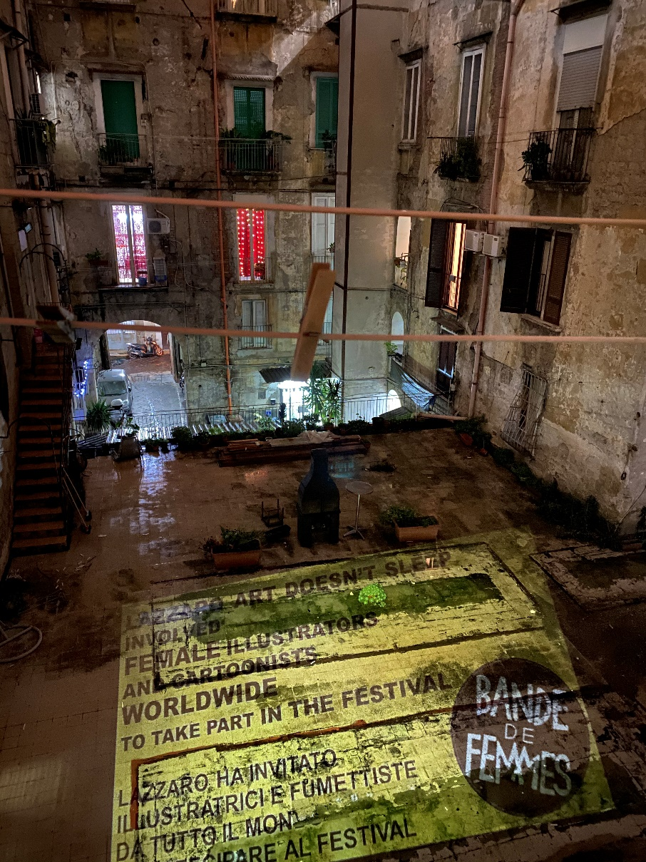
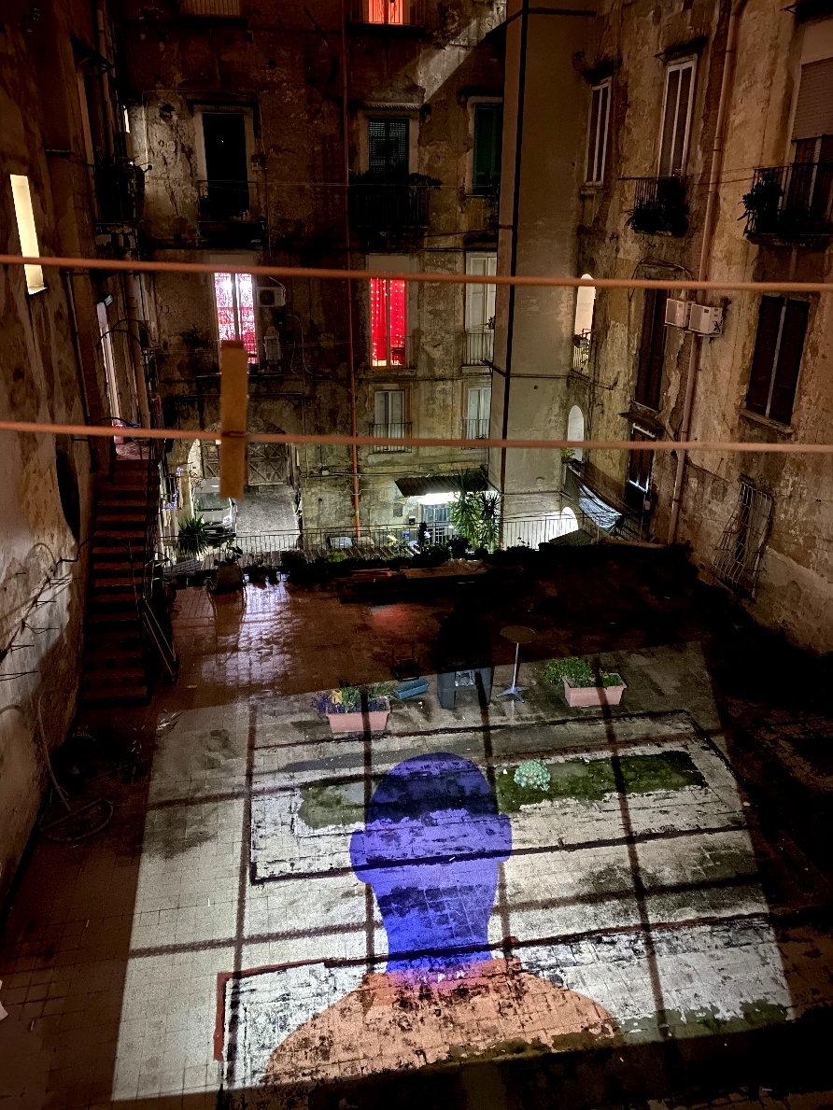
Napoli
Lazzaro_art doesn’t sleep Claudia Pecoraro

Slide 31
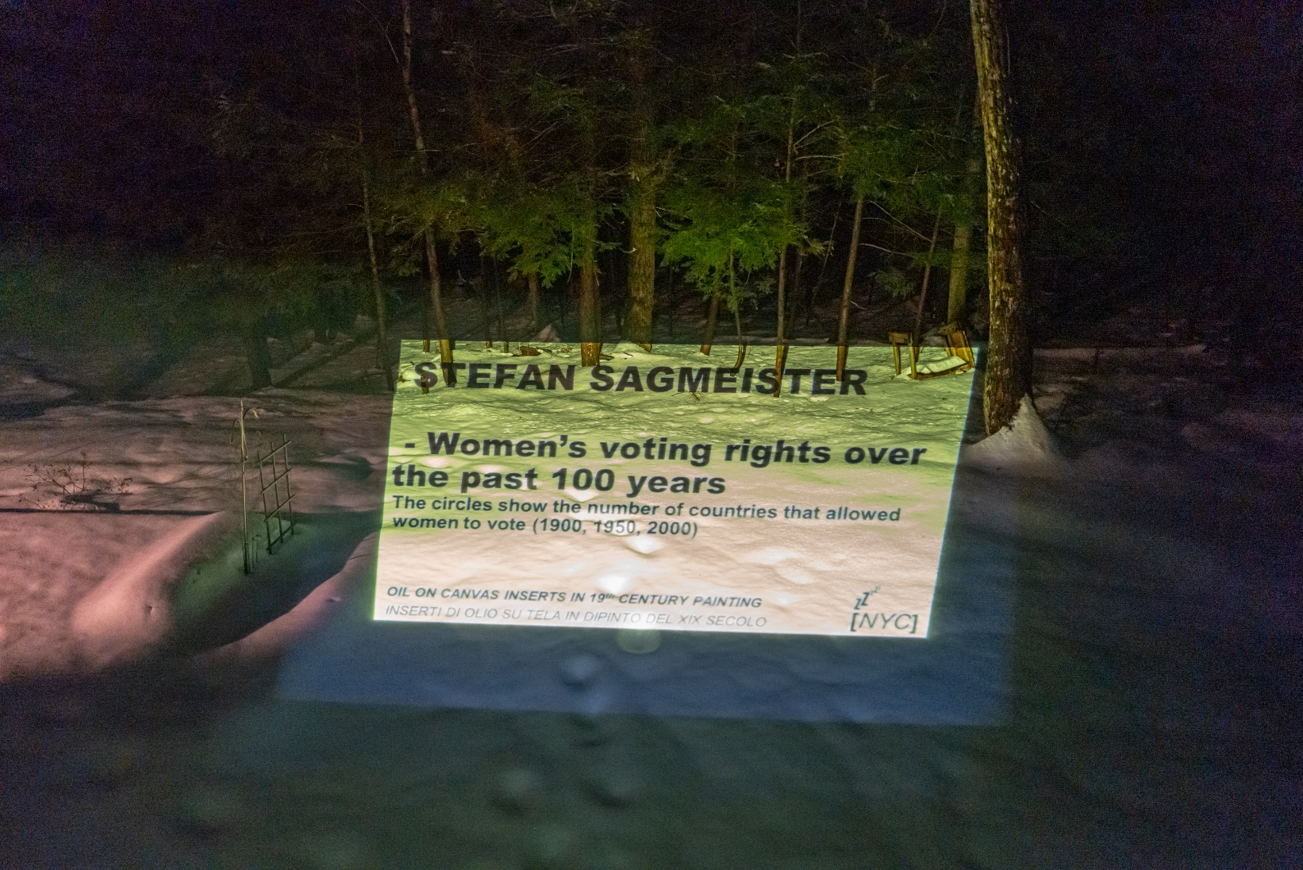
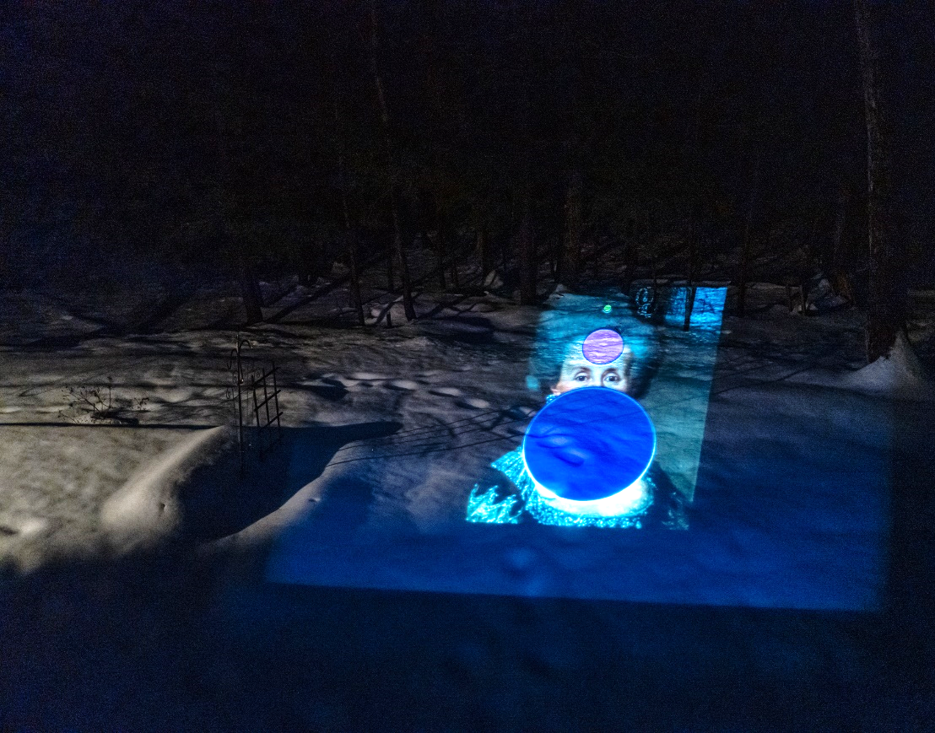
Stroudsbourg, Pennsylvania
Lazzaro_art doesn’t sleep Claudia Pecoraro

Slide 32
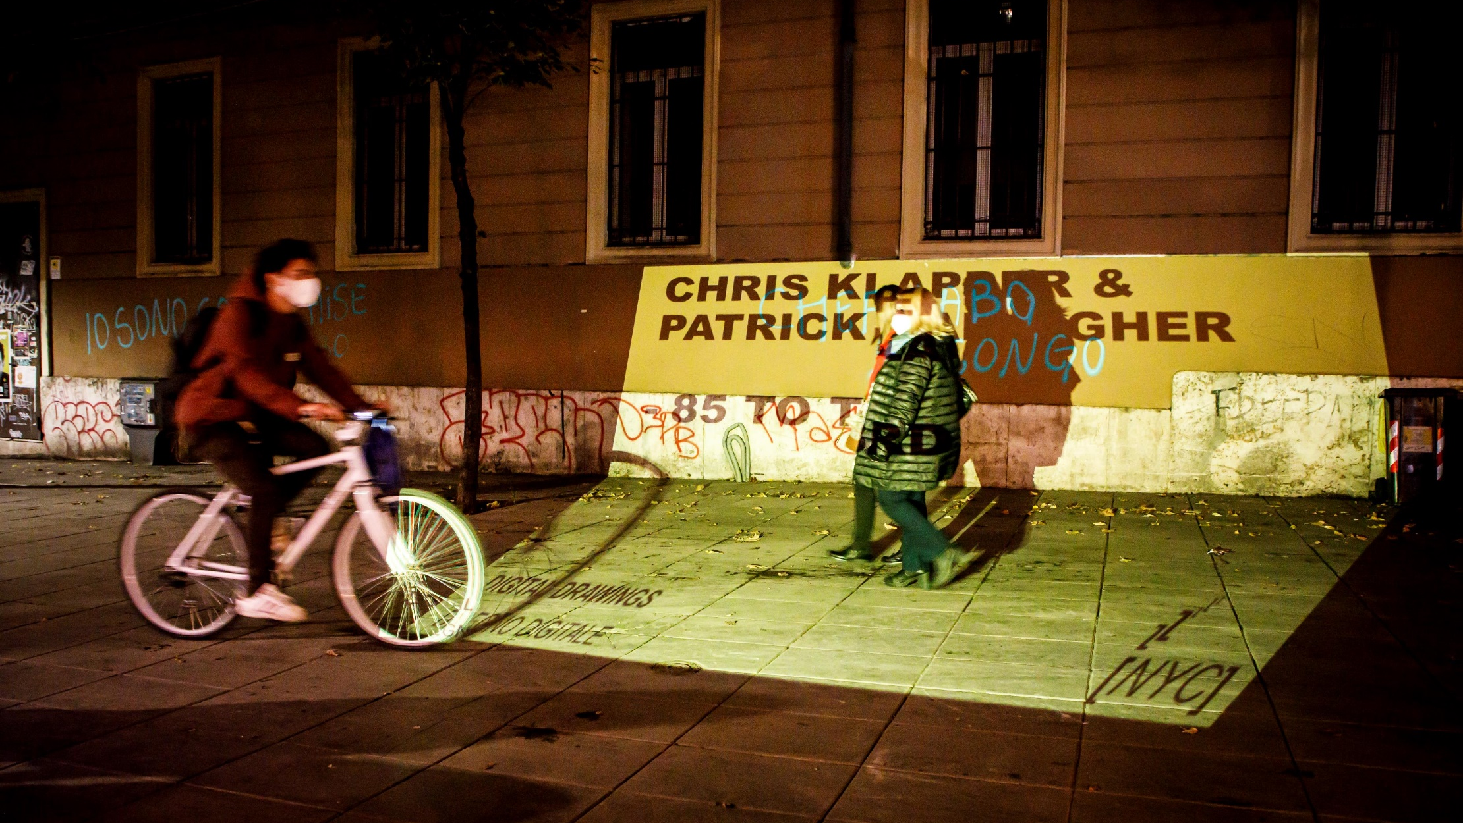
Roma
Lazzaro_art doesn’t sleep Claudia Pecoraro

Slide 33
Lazzaro_art doesn’t sleep Claudia Pecoraro

